Slide 1

SONI COMPUTER CLASSES
HISTORY OF LINUX
We read Unix history before starting Linux History, b’coz Unix known as father of Linux.
The Unix operating system was implemented in 1969 at AT&T's Bell Laboratories in the United States by Ken Thompson, Dennis Ritchie, Douglas McIlroy, and Joe Ossanna. It was first released in 1971 and was initially entirely written in assembly language, Unix was re-written in the programming language C by Dennis Ritchie, (with exceptions to the kernel and I/O). The availability of an operating system written in a high-level language allowed easier portability to different computer platforms and Unix became widely adopted by academic institutions and businesses. It was not opensource code operating system
Ravi Kant Soni +918269000074
Ravi Kant Soni +918269000074

Slide 2
GNU PROJECT
The name “GNU” is a recursive acronym for “GNU's Not Unix!”. The GNU Project, started in 1983 by Richard Stallman, had the goal of creating a "complete Unix-compatible software system" composed entirely of free software. Work began in 1984. Later, in 1985, Stallman created the Free Software Foundation and wrote the GNU General Public License (GNU GPL) in 1989. By the early 1990s, many of the programs required in an operating system (such as libraries, compilers, text editors, a Unix shell, and a windowing system) were completed, although low-level elements such as device drivers, daemons, and the kernel were stalled and incomplete
Ravi Kant Soni +918269000074
MINIX
MINIX was an inexpensive minimal Unix-like operating system, designed for education in computer science, written by Andrew S. Tanenbaum (now MINIX is free and redesigned also for “serious” use).
Ravi Kant Soni +918269000074

Slide 3
LINUX
In 1991 while attending the University of Helsinki, Linus Benedict Torvalds began to work on a non-commercial replacement for MINIX, which would eventually become the Linux kernel. Torvalds began the development of Linux on MINIX and applications written for MINIX were also used under Linux. Later Linux matured and it became possible for Linux to be developed under itself. Also GNU applications replaced all MINIX ones because, with code from the GNU system freely available, Torvalds make to a fully functional and free operating system (Open Source Code).
The First Linux kernel, started independently by Linux Torvalds in 1991 , and Linux version 0.01 was released under the GPL in 1992
Ravi Kant Soni +918269000074
Ravi Kant Soni +918269000074

Slide 4
Master Boot Record (MBR)
The Master Boot Record (MBR) is a small, dedicated section at the beginning of the hard disk which holds the boot information and partition layout for the whole disk. The MBR itself is only a single physical sector in length (512 bytes)
Partition Table
The partition table effectively retains the particular details for each primary partition on the disk, such as starting position, size, type, status, etc. A standard MBR reserves space for up to four partitions. The 64 bytes are reserved for this.
Ravi Kant Soni +918269000074
Boot Loader
A program that loads the operating system into memory. The first 446 bytes of the disk are reserved for Boot Loader in MBR & is dedicated to telling the computer how to boot. When a machine first starts it needs to locate the necessary operating system files on the hard disk, The boot loader is actually a small program which identifies the active (bootable) partition, then redirects the boot process to that location. The boot loader allows you to easy create and configure a boot menu so that you can select which OS to boot.
Ravi Kant Soni +918269000074

Slide 5
Master Boot Record (MBR)
Magic Number
Located in the final two bytes of the MBR (511-512), this section must contain the hex value 0xAA55 , which officially classifies this as a valid MBR.
Ravi Kant Soni +918269000074
Ravi Kant Soni +918269000074

Slide 6
Why we prefer to Linux OS
Windows
Linux
Super User ( administrator )
Super User ( root )
Case Insensitive O/S
Case Sensitive O/S
Ravi Kant Soni +918269000074
Licensed & Pirated O/S
Licensed & Free O/S
File Extension support .exe
File Extension support .rpm
Infected by virus
Virus free operating system
Not an open source code
An Open source code
FAT16,FAT32 & NTFS file system
EXT3 EXT2 file system
Drive Letter C:\
Mount Point /
Non secure boot loader ( NTLDR )
Secure boot loader ( GRUB ) , LILO
Ravi Kant Soni +918269000074

Slide 7

Linus Torvalds
Torvalds in 2009
Born | December 28, 1969 (age 40) Helsinki, Finland
Residence | Portland Oregon
Nationality | Finnish
Occupation | Software engineer
Employer | Linux Foundation
Known for | Linux kernel
Parents | Nils Torvalds (father) Anna Torvalds (mother)
Relatives | Ole Torvalds (grandfather)
IANT RAIPUR
Ravi Kant Soni +918269000074

Slide 8
FILE SYSTEM
EXT2
Extended 2
Extended 3
EXT3
Ext2 filesystem is the lower version of ext3
Ext3 filesystem is nothing but next version of
ext2
EXT2 was initially designed by Remy Card in
1992
ext3 was developed by Dr.Stephen Tweedie
in 1999
Ravi Kant Soni +918269000074
EXT2 takes long time for format the partition
EXT3 takes less time for format the partition
EXT2 filesystem can be down maximum time
EXT3 is a robust and fast filesystem with a
minimum of downtime
EXT2 has no journaling feature
EXT3 has journaling feature
EXT2 can upgrade with EXT3 filesystem
EXT3 can’t convert with EXT2 filesystem
Ravi Kant Soni +918269000074

Slide 9
BOOT LOADER
GRUB
LILO
GRand Unified Bootloader
Linux LOder
GRUB is the updated version
LILO is the older version
GRUB does support booting from a network
Ravi Kant Soni +918269000074
LILO does not support booting from a network
GRUB has a interactive command interface
LILO has no interactive command interface
GRUB is support recover your operating
System
GRUb provides security in boot loader
LILO does not support to recover your
operating system
LILO does not support to security in boot
Loader
Ravi Kant Soni +918269000074

Slide 10
DIRECTORY STRUCTURE of WINDOWS
C:\
Document & Settings
Program Files
Windows
Recycle Bin
IANT
Ravi Kant Soni +918269000074

Slide 11
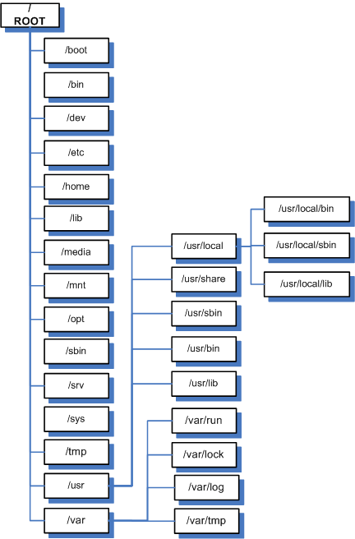
DIRECTORY STRUCTURE of LINUX
Ravi Kant Soni +918269000074
Ravi Kant Soni +918269000074

Slide 12
Directory Structure
/
The Directory Structure starts with the Root file system “/”
/boot
This is the default location where stored all bootable files & directory.
/etc
This is where you'll find all your global settings. All configuration files here.
/sbin
Store all commands which is related to Super User root.
/bin
Store all commands which is related to normal user & Super User root.
Ravi Kant Soni +918269000074
Ravi Kant Soni +918269000074

Slide 13
/root
This is the default home directory for the Super User root.
/home
This is the default directory where non-root users' homes are created. When you add a user, the default home directory is created as /home/username.
/lib
This is where shared libraries (perl, python, C, etc.) are stored.
/mnt /opt /media /net
This is the default location for mounting cdroms, floppy disk drives, USB memory sticks, etc. You can mount anything anywhere, but by default there is a /mnt/cdrom.
/dev
This is a virtual directory where your devices are stored. Devfs allows Linux to list devices (hard drives, input devices, modems, sound cards, etc.) as files.
Ravi Kant Soni +918269000074
Ravi Kant Soni +918269000074

Slide 14
/proc
This virtual folder contains information about your system. You can view processor statistics/specifications, PCI / USB information, and pretty much anything else you want to know about the hardware on your system.
/tmp
This is the default location to place files for temporary use. When you install a program, it uses /tmp to put files during installation that won't be needed once the program is installed.
/usr
This contains various programs, non-daemon program settings and program resources. Stored all help related documents.
/var
This is where your log files, system mail messages and database of installed programs are stored.
Ravi Kant Soni +918269000074
Ravi Kant Soni +918269000074

Slide 15
/sys
This contains the Kernel and system related files
/srv
Data for services provided by this system
/lost+found
It works as a recycle bin
Ravi Kant Soni +918269000074
Ravi Kant Soni +918269000074

Slide 16
IDE CONTROLLER
Ravi Kant Soni +918269000074
PRIMARY
SECONDARY
Master
Slave
Master
Slave
/dev/hda
/dev/hdb
/dev/hdc
/dev/hdd
Ravi Kant Soni +918269000074

Slide 17
SATA CONTROLLER
Ravi Kant Soni +918269000074
/dev/sda
/dev/sdb
/dev/sdc
/dev/sdd
This controller is also used for SCSI & USB Disk
Ravi Kant Soni +918269000074

Slide 18
TYPE OF PARTITION
Ravi Kant Soni +918269000074
PRIMARY
EXTENDED
LOGICAL
Ravi Kant Soni +918269000074

Slide 19
TYPE OF PARTITION
Ravi Kant Soni +918269000074
3 PRIMARY
2 PRIMARY
1 PRIMARY
1 EXTENDED
1 EXTENDED
1 EXTENDED
4 PRIMARY
1 PRIMARY
LOGICAL
LOGICAL
LOGICAL
/dev/hda1 (P)
/dev/hda2 (P)
/dev/hda3 (P)
/dev/hda4 (P)
/dev/hda1 (P)
/dev/hda2 (P)
/dev/hda3 (P)
/dev/hda4 (E)
/dev/hda5 (L)
/dev/hda6 (L)
/dev/hda1 (P)
/dev/hda2 (P)
/dev/hda3 (E)
/dev/hda5 (L)
/dev/hda6 (L)
/dev/hda1 (P)
/dev/hda2 (E)
/dev/hda5 (L)
/dev/hda6 (L)
/dev/hda1 (P)
Ravi Kant Soni +918269000074

Slide 20
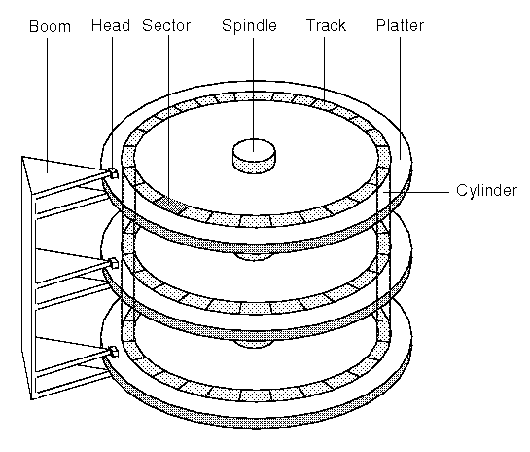
Ravi Kant Soni +918269000074
Ravi Kant Soni +918269000074

Slide 21
HARD DISK CYLINDER SIZE
CYLINDER VALUE
CYLINDER VALUE AVERAGE
80GB = 9730
40GB = 4865
20GB = 2432
10GB = 1216
1GB = 121
512M = 60
124M = 12
12M = 1
80GB = 8000
40GB = 4000
20GB = 2000
10GB = 1000
1GB = 100
512M = 50
100M = 10
10M = 1
Ravi Kant Soni +918269000074
Ravi Kant Soni +918269000074

Slide 22
HDD PARTITION TABLE
Dual Boot with W2k8 & RedHat Linux
Start Cyl
1
Primary 2K8
/dev/hda1
C Drive 10 gb with NTFS
1001
1000
Primary
/dev/hda2
D Drive 20 gb with NTFS
3001
Primary Linux
/dev/hda3
3000
Ravi Kant Soni +918269000074
/ 10 gb with EXT3
4001
4000
4001
Logical Swap
/dev/hda5
2 GB twice of RAM with swap FS
/dev/hda4
4201
4200
Logical
/dev/hda6
Extended Partition
/data 18 gb with EXT3
6001
6000
Logical
/dev/hda7
E Drive 20 gb with FAT32
8000
8000
8000
End Cyl
Ravi Kant Soni +918269000074

Slide 23
HDD PARTITION TABLE
Installation Only of RedHat Linux
Start Cyl
1
Primary Linux
/dev/hda1
/ boot 100M with EXT3
101
100
Primary
/dev/hda2
/ 20 gb with EXT3
2101
Primary Linux
/dev/hda3
2100
Ravi Kant Soni +918269000074
/home 9 gb with EXT3
3001
3000
3001
Logical Swap
/dev/hda5
2 GB twice of RAM with swap FS
/dev/hda4
3201
3200
Logical
/dev/hda6
Extended Partition
/var 18 gb with EXT3
5001
5000
Logical
/dev/hda7
/data 30 gb with EXT3
8000
8000
8000
End Cyl
Ravi Kant Soni +918269000074

Slide 24
HDD PARTITION TABLE
Installation Only of RedHat Linux
Start Cyl
1
Primary Linux
/dev/hda1
/ 10 GB with EXT3
1001
1000
Primary Swap
/dev/hda2
2 GB twice of RAM with swap FS
1201
1200
Ravi Kant Soni +918269000074
Primary Linux
/dev/hda3
/data 68 GB with EXT3
8000
End Cyl
Ravi Kant Soni +918269000074

Slide 25
INSTALLATION
INSTALLATION MODE
GRAPHICAL
TEXT
Ravi Kant Soni +918269000074
INSTALLATION METHOD
LOCAL CDROM
HDD IMAGE
NFS
FTP
HTTP
Ravi Kant Soni +918269000074

Slide 26
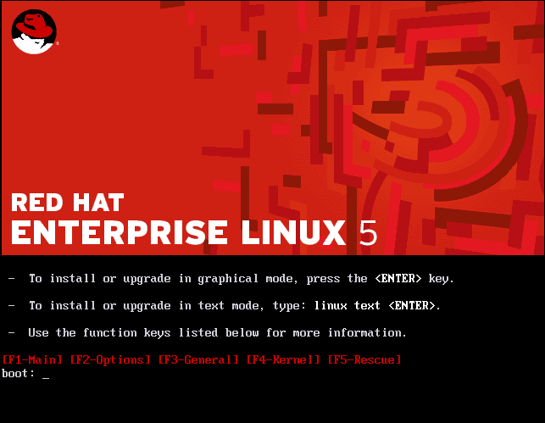
INSTALLATION
Set first boot device CD / LAN / NETWORK
Ravi Kant Soni +918269000074
Ravi Kant Soni +918269000074

Slide 27
INSTALLATION
boot:
installation from graphical mode using local cdrom
boot:linux text
installation from text mode using local cdrom
boot:linux askmethod
installation from graphical mode using 5 types method
boot:linux askmethod text
installation from text mode using 5 types method
boot:linux rescue
For rescue mode (troubleshooting)
boot:local
For boot from local hard disk
Ravi Kant Soni +918269000074
Ravi Kant Soni +918269000074

Slide 28

INSTALLATION SERVER
Server name server1.example.com
Server IP 172.24.254.254
INSTALLED SERVICE
DHCP For provide IP to all clients
NFS For shared data
FTP For shared data
HTTP For shared data
Shared directory from server /rhel5.3
Ravi Kant Soni +918269000074
Ravi Kant Soni +918269000074

Slide 29
RUNLEVEL
The term runlevel refers to a mode of operation in one of the computer operating systems. seven runlevels exist, numbered from zero to six
COMMAND | DESCRIPTION
# init 0 | Use for Shutdown the system
# init 1 | Use for Single use mode, without authentication, without graphical, without NFS
# init 2 | Use for Multiuser mode, without graphical & NFS
# init 3 | Use for Multiuser mode, without graphical, but with NFS
# init 4 | Not-Used
# init 5 | Use for Multiuser mode, with graphical & NFS
# init 6 | Use for Restart the system
Ravi Kant Soni +918269000074
Ravi Kant Soni +918269000074
S, s is also used for single user mode
Ravi Kant Soni +918269000074

Slide 30
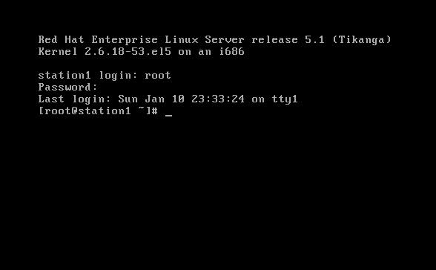

TERMINAL TYPE (TTY)
Linux is support multi user mode, means we can login via multi user on single machine
without logoff by any user. Linux supports default 7 users login on a single machine
first to six command line terminal, last will be for graphical
Ravi Kant Soni +918269000074
Ravi Kant Soni +918269000074

Slide 31
For switching from graphical to text
For switching from text to text
CTRL + ALT + F1
CTRL + ALT + F2
CTRL + ALT + F3
CTRL + ALT + F4
CTRL + ALT + F5
CTRL + ALT + F6
ALT + F1
ALT + F2
ALT + F3
ALT + F4
ALT + F5
ALT + F6
Ravi Kant Soni +918269000074
For switching from text to graphical
ALT + F7
We can extend command line terminal upto 12
Ravi Kant Soni +918269000074

Slide 32
BASIC COMMANDS
[root@station1~]# tty
for identify to current terminal type
[root@station1~]# runlevel
For check to current run level
[root@station1~]# pwd
print working directory
[root@station1~]# whoami
For check to current user
[root@station1~]# who
How many user is login on which terminal
[root@station1~]# bc
To run basic calculator
Ravi Kant Soni +918269000074
Ravi Kant Soni +918269000074

Slide 33
[root@station1~]# date
For check current date & time
[root@station1~]# date +%r
For check current time with 12 hour format
[root@station1~]# date +%R
For check current time with 24 hour format
[root@station1~]# date 123115302010
For change current date & time with format ( MMDDHHMNYY )
[root@station1~]# cal
For view current month calendar
[root@station1~]# cal 01 2010
For view jan month calendar of 2010
[root@station1~]# cal 2010
For view calendar of whole 2010 year
Ravi Kant Soni +918269000074
Ravi Kant Soni +918269000074

Slide 34
[root@station1~]# dir
to view all files & dir of current location
[root@station1~]# ls
To view all files & dir (same as a ls difference only of colors)
Dir = Blue, File = white, Shortcut = Sky Blue, Red = Compress
[root@station1~]# ls -l
To view all files & dir with List wise ( Normal )
[root@station1~]# ls -a
To view of all files & dir ( Normal & Hidden )
[root@station1~]# ls -la
To view all files & dir with List wise ( Normal & Hidden )
[root@station1~]# ls /
To view all file & dir of / location
[root@station1~]# ls -la | less
For see the content pagewise
Ravi Kant Soni +918269000074
Ravi Kant Soni +918269000074

Slide 35
[root@station1~]# ls -la | more
For see the content pagewise
[root@station1~]# cd .
To reload your current directory
[root@station1~]# cd ..
To switch into previous dir
[root@station1 / ]# cd etc
To change directory
[root@station1 etc]# cd /usr
To change directory of / location from any other location like from etc
[root@station1 usr]# cd -
To switch between two directory
[root@station1~]# cd /etc/sysconfig
To switch direct into child directory
Ravi Kant Soni +918269000074
Ravi Kant Soni +918269000074

Slide 36
[root@station1 /]# touch text
For create a blank file
[root@station1 /]# touch file1 file2 file3 file4
For create multiple file
[root@station1 /]# touch test{1,2,3,4,5}
For create multiple file with the name test1, test2, test3…………
[root@station1 /]# touch /tmp/myfile
For create a blank at other location
[root@station1 /]# cat filename
For read the content of existing file
[root@station1 /]# head filename
For see only first 10 lines in file
[root@station1 /]# tail filename
For see only last 10 lines in file
Ravi Kant Soni +918269000074
Ravi Kant Soni +918269000074

Slide 37
[root@station1 /]# cat > filename
To create a new file, for save put a cursor at blank line use ctrl + c
[root@station1 /]# cat >> filename
To append the content in existing file, again for save put a cursor at blank line use ctrl + c
[root@station1 /]# cp filename /mnt
For copy a file at /mnt location
[root@station1 /]# cp filename /opt/newname
For copy a file at /opt location with a new name
[root@station1 /]# cp file1 file2 file3 /mnt
For copy multiple file at /mnt location
[root@station1 /]# cp -v file1 file2 file3 /mnt
For copy multiple file at /mnt location if you want to see background detail so use –v (verbose mode)
Ravi Kant Soni +918269000074
Ravi Kant Soni +918269000074

Slide 38
[root@station1 /]# cp -r dirname /mnt
For copy a directory at /mnt location
[root@station1 /]# cp -r dirname /mnt/newname
For copy a directory at /mnt location with a new name
[root@station1 /]# cp -r dir1 dir2 dir3 dir4 /mnt
For copy multiple directory at /mnt location
[root@station1 /]# mv filename /mnt
For move a single file
[root@station1 /]# mv filename /mnt/newname
For move a single file with a different name
[root@station1 /]# mv file1 file2 file3 file4 /mnt
For move multiple file at /mnt location
[root@station1 /]# mv filename newname
For rename a single file with a new name
Ravi Kant Soni +918269000074
Ravi Kant Soni +918269000074

Slide 39
[root@station1 /]# mv dirname /mnt
For move a single directory
[root@station1 /]# mv dirname /mnt/newname
For move a single directory with a different name
[root@station1 /]# mv dir1 dir2 dir3 dir4 /mnt
For move multiple directory at /mnt location
[root@station1 /]# mv dirname newname
For rename a single directory with a new name
[root@station1 /]# du -sh filename
For show the size of file
[root@station1 /]# du -sh dirname
For show the size of directory
Ravi Kant Soni +918269000074
Ravi Kant Soni +918269000074

Slide 40
[root@station1 /]# rm filename
For remove a single file it will prompt for confirmation.
[root@station1 /]# rm -f filename
For remove a single file it will not prompt for confirmation, it will delete a file with forcefully.
[root@station1 /]# rm -f file1 file2 file3
For remove multiple file it will not prompt for confirmation, it will delete multiple file with forcefully.
[root@station1 /]# rmdir dirname
For remove a blank directory, it will not prompt for confirmation
[root@station1 /]# rmdir dir1 dir2 dir3 dir4
For remove multiple directory, it will also not prompt for confirmation
[root@station1 /]# rm -r dirname
For remove directory , subdirectory & file also, it will prompt for confirmation for each one. -r is use for recursive
Ravi Kant Soni +918269000074
Ravi Kant Soni +918269000074

Slide 41
[root@station1 /]# rm –r dir1 dir2 dir3 dir4
For remove multiple directory, it will also prompt for each directory, subdirectry & file also.
[root@station1 /]# rm –rf dir1
For remove a singe directory, it will not prompt for confirmation.
[root@station1 /]# rm –rf dir1 dir2 dir3 dir4
For remove multiple directory, it will not prompt for confirmation.
[root@station1 /]# rm –rf dir1 dir2 dir3 file1 file2 file3
For remove multiple directory & file also, it will not prompt for confirmation.
[root@station1 /]# find / -name filename
For search to a file at / location
[root@station1 /]# find / -name dirname
For search to a dir at / location
Ravi Kant Soni +918269000074
Ravi Kant Soni +918269000074

Slide 42
[root@station1 /]# fdisk -l
For show the partition detail of your hard disk & usb devices if any
[root@station1 /]# df
For show the mount point of your all partition, as well as show the total, Free, Available size ( in kb ) partition
[root@station1 /]# df -m
For show the mount point of your all partition, as well as show the total, Free, Available size ( in mb ) partition
[root@station1 /]# df -h
For show the mount point of your all partition, as well as show the total, Free, Available size ( in gb ) partition
[root@station1 /]# mount
For identify the file system of any partition, mount point and permission also
Ravi Kant Soni +918269000074
Ravi Kant Soni +918269000074

Slide 43
[root@station1 /]# eject
For tray out ( open cdrom tray )
[root@station1 /]# eject -t
For tray close ( close cdrom tray )
[root@station1 /]# man ls
For see the manual pages of ls command
[root@station1 /]# info ls
For see the options of ls command
[root@station1 /]# ls --help
For see the help of ls command
[root@station1 /]# which init
For see the location of commands
[root@station1 /]# ps -t tty2
For view the process id of terminal 2
Ravi Kant Soni +918269000074
Ravi Kant Soni +918269000074

Slide 44
[root@station1 /]# ps -a
For view process id of all terminal
[root@station1 /]# kill -9 1234
For kill process id 1234 ( -9 is use for forcefully)
[root@station1 /]# startx
Force switch into graphical mode
(or)
[root@station1 /]# X
Force switch into graphical mode
[root@station1 /]# history
For show the last 1000 commands, It is stored in /root/.bash_history
[root@station1 /]# history -c
For remove the history commands
[root@station1 /]# clear
For clear the screen
Ravi Kant Soni +918269000074
Ravi Kant Soni +918269000074

Slide 45
[root@station1 /]# exit
For logout via current user
( or )
[root@station1 /]# logout
For logout via current user
(or)
[root@station1 /]# ctrl + d
Shortcut for logout via current user
[root@station1 /]# ctrl + alt + del
Shortcut for reboot your system
[root@station1 /]# echo “message”
For print the message on current terminal
[root@station1 /]# echo “message” > filename
For redirect the out in a file
[root@station1 /]# echo “message” >> filename
For append the out in a file
Ravi Kant Soni +918269000074
Ravi Kant Soni +918269000074

Slide 46
[root@station1 /]# wall “message”
For print the message at all terminal where is user login
[root@station1 /]# alias c=clear
For set alias of clear command
[root@station1 /]# alias
For view to all available alias
[root@station1 /]# unalias c
For remove alias which is started from c
[root@station1 /]#
[root@station1 /]#
[root@station1 /]#
Ravi Kant Soni +918269000074
END
Ravi Kant Soni +918269000074

Slide 47
VI EDITOR
( VI IMPROVED )
[root@station1 /]# vi filename
For create a new file or open to existing file
insert for switch into insert mode
(or)
i for switch into insert mode
insert (2 time) for switch into replace mode
esc 1 yy for copy a single line (1 is the no. of line)
esc p for paste
esc 1 cc for cut a single line (1 is the no. of line)
esc 1 dd for delete a single line (1 is the no. of line)
Ravi Kant Soni +918269000074
Ravi Kant Soni +918269000074

Slide 48
VI EDITOR
( VI IMPROVED )
esc :set nu for set line no. in file
esc :set nonu for remove line no. in file
esc :25 for goto line no
esc u for undo
ctrl r for redo
ctrl g for view to line no. at right side bottom
esc /word for search any word in a file
esc n for repeat last search ( next search )
esc :%s/oldword/newword for replace word
Ravi Kant Soni +918269000074
Ravi Kant Soni +918269000074

Slide 49
VI EDITOR
( VI IMPROVED )
esc o for insert a blank line
ctrl y for copy upper line
ctrl e for copy lower line
esc :w for only save
esc :w newname for save as
esc :q for quit when u not modified in file
esc :q! for quit when u don’t want to save any changes ( ! Forcefully )
esc :wq for save & exit
esc :wq! for save & exit with forcefully option
Ravi Kant Soni +918269000074
Ravi Kant Soni +918269000074

Slide 50
[root@station1 /]# vim filename
VIM is also use as a vi but it has some advance feature
(ex. Lineno, password, colors)
[root@station1 /]# vim -x filename
For set encryption key in new file or in existing file
[root@station1 /]# vim +100 filename
for open to a file at line no 100
[root@station1 /]# cat filename | grep word
for search to a word in a file
[root@station1 /]# vim /etc/issue
For set message before login
[root@station1 /]# vim /etc/motd
For set message after login
[root@station1 /]# vim /etc/bashrc
For set aliases permanent
Ravi Kant Soni +918269000074
END
Ravi Kant Soni +918269000074

Slide 51
TAR GZIP & BZIP2
All utility is use for compress the data but some difference between them see:-
TAR | GZIP | BZIP2
Tar use extension .tar | Gzip use extension .gz | Bzip2 use extension .bz2
Tar is archive file format | Gzip is not a archive format | Bzip2 is not a archive format
Tar can be compress to folder & file both | Gzip can compress to only of files not to folder | Bzip2 can compress to only of files not to folder
Tar provides low compression ratio | Gzip provides medium compression ratio | Bzip2 provides higher compression ratio
Tar is faster comparison gzip & bzip2 | Gzip is slower than tar, but is normally faster than bzip2 | Bzip2 is slower than tar & gzip but it creates a smaller files
Ravi Kant Soni +918269000074
Ravi Kant Soni +918269000074

Slide 52
TAR
[root@station1 /]# mkdir /backup
Create a directory for take backup/compression
[root@station1 /]# cp -rv /etc /backup
copy some data in /backup folder for compression
[root@station1 /]# du -sh /backup
For view the size of /backup
[root@station1 /]# tar -cvf /backup.tar /backup
For create a .tar file of /backup folder ( For compress )
( c=compress, v=verbose, f=file format)
[root@station1 /]# ls
you will see a compress file with the name backup.tar & backup folder also
[root@station1 /]# du -sh /backup.tar
For view the size of /backup.tar
Ravi Kant Soni +918269000074
Ravi Kant Soni +918269000074

Slide 53
[root@station1 /]# rm -rf /backup
For remove original folder /backup
[root@station1 /]# tar -tvf /backup.tar
For view the content of compress file
[root@station1 /]# tar -xvf /backup.tar
For extract the compress file (x=extract, v=verbose, f=file format)
[root@station1 /]# ls
You can view the original folder & compress file also
[root@station1 /]# du -sh /backup
You can again check your folder size it as previous size
Ravi Kant Soni +918269000074
Ravi Kant Soni +918269000074

Slide 54
GZIP
[root@station1 /]# du -sh /backup.tar
You have to check the size for .tar file
[root@station1 /]# gzip /backup.tar
For compress to backup.tar file with the extension .gz
[root@station1 /]# ls
You can view the compress file with the name backup.tar.gz
[root@station1 /]# du -sh /backup.tar.gz
You can again check your file size it has been compressed
[root@station1 /]# gunzip /backup.tar.gz
For extract the compress file
[root@station1 /]# ls
You can view you original file with the name backup.tar
Ravi Kant Soni +918269000074
Ravi Kant Soni +918269000074

Slide 55
BZIP2
[root@station1 /]# du -sh /backup.tar
You have to check the size for .tar file
[root@station1 /]# bzip2 /backup.tar
For compress to backup.tar file with the extension .bz2
[root@station1 /]# ls
You can view the compress file with the name backup.tar.bz2
[root@station1 /]# du -sh /backup.tar.bz2
You can again check your file size it has been compressed more than tar & gzip
[root@station1 /]# bunzip2 /backup.tar.bz2
For extract the compress file
[root@station1 /]# ls
You can view you original file with the name backup.tar
Ravi Kant Soni +918269000074
END
Ravi Kant Soni +918269000074

Slide 56
CRONTAB
Cron jobs are used to shedule commands to be execute periodically. Cron enables users to schedule jobs to run automatically at a certain date or time. Just suppose if you want to create a directory at particular location and particular command.
Syntax of crontab
* * * * * location of command argument
min hour date month day of
the week
00 00 01 01 00
59 23 31 12 07
(00 & 07 is use for sunday)
[root@station1 /]# which mkdir
First you have to identify the location of mkdir command
/bin/mkdir
Ravi Kant Soni +918269000074
Ravi Kant Soni +918269000074

Slide 57
For edit in crontab for current user (root)
[root@station1 /]# crontab -e
(or)
For edit in crontab for user root
[root@station1 /]# crontab -u root -e
20 * * * /bin/mkdir /redhat
esc :wq (Save & exit)
It will be create a directory with the name /redhat at 08:15 P.M
[root@station1 /]# service crond restart
For restart the service of crond
[root@station1 /]# crontab -l
For list of crontab for current user (root)
[root@station1 /]# crontab -r
For remove the crontab for current user (root)
Ravi Kant Soni +918269000074
Ravi Kant Soni +918269000074

Slide 58
some combination for crontab
15 20 * * * /bin/touch /linux
For create a file with the name /linux at 08:15 P.M on daily basis.
15 20 01 * * /bin/touch /linux
For create a file with the name /linux at 08:15 P.M. on 01 date of every month
15 20 * 01 * /bin/touch /linux
For create a file with the name /linux at 08:15 P.M. on every day in january month
15 20 * * 01 /bin/touch /linux
For create a file with the name /linux at 08:15 P.M. on every Monday
15 20 * 04 01 /bin/touch /linux
For create a file with the name /linux at 08:15 P.M. on every monday in april
15 20 05 04 01 /bin/touch /linux
For create a file with the name /linux at 08:15 P.M. on every monday in april, but date also should be 5th
Ravi Kant Soni +918269000074
Ravi Kant Soni +918269000074

Slide 59
some combination for crontab
15 20 01,15 * * /bin/touch /linux
For create a file with the name /linux at 08:15 P.M. on 01st date & 15th date of the month .
*/5 * * * * /sbin/init 6
For reboot your system in every 5 minutes
15 20 * * * /bin/echo “message”
For send a mail to the current user at 08:15 P.M on daily basis.
15 20 * * * /usr/bin/wall “plz shutdown your system”
For send a broadcast message to all logged user at 08:15 P.M. on daily basis
15 20 * * * /sbin/init 6
For reboot your system via super user at 08:15 P.M. on daily basis
Ravi Kant Soni +918269000074
END
Ravi Kant Soni +918269000074

Slide 60
LINKS / SHORTCUT
Links is create for easy access of data. Two types of links are available in linux
SOFT | HARD
Soft link is also know as symbolic/symlink also | Hard links known as only by the name hard link
You can create a symlink for a directory & file both | You cannot create a hardlink for a directory
If you remove the original file of symlinks the link will not show you the content of the file | If you remove the original file of hard links the link will still show you the content of the file
Softlink can cross the filesystem | Hardlink cannot cross the filesystem
Softlink is create different inode no. | Hardlink is create same inode no.
Ravi Kant Soni +918269000074
[root@station1 /]# ls -il filename
For view the inode no. of file / directory
Ravi Kant Soni +918269000074

Slide 61
SYMBOLIC LINKS
[root@station1 /]# mkdir -p /world/india/cg/raipur/iant
For create a directory & subdirectory
[root@station1 /]# vim /world/india/cg/raipur/iant/lab3
create a new file in
[root@station1 /]# ln -s /world/india/cg/raipur/iant/lab3 /
for create a soft link at / location
[root@station1 /]# ls
For view the soft link at / location
[root@station1 /]# vim /lab3
For view the content of link file
[root@station1 /]# rm -rf /world/india/cg/raipur/iant/lab3
For remove the original file than you cannot recover from link
Ravi Kant Soni +918269000074

Slide 62
HARD LINKS
[root@station1 /]# mkdir -p /world/india/cg/raipur/iant
For create a directory & subdirectory
[root@station1 /]# vim /world/india/cg/raipur/iant/lab3
create a new file in
[root@station1 /]# ln /world/india/cg/raipur/iant/lab3
for create a hard link at / location
[root@station1 /]# ls
For view the hard link at / location
[root@station1 /]# vim /lab3
For view the content of link file
[root@station1 /]# rm -rf /world/india/cg/raipur/iant/lab3
For remove the original file than you can recover from link
Ravi Kant Soni +918269000074
END
Ravi Kant Soni +918269000074

Slide 63
NETWORK CONFIGURATION
we will cover in this :- how to configure IP Address , Subnet Mask,
Gateway Address, DNS Address & Hostname
[root@station1 /]# ifconfig
For view the interface information of ethernet0 ( eth0 ) loopback ( lo )
(ip address, subnetmask, broadcast address, mac address)
[root@station1 /]# ifconfig eth0
For view the informations of only eth0
[root@station1 /]# ifconfig lo
For view the informations of only lo
[root@station1 /]# ifdown eth0
For disable the interface eth0
[root@station1 /]# ifdown lo
For disable the interface lo
Ravi Kant Soni +918269000074
Ravi Kant Soni +918269000074

Slide 64
[root@station1 /]# ifconfig
You will be see all interface has been disabled
[root@station1 /]# ifup eth0
For enable interface eth0
[root@station1 /]# ifup lo
For enable interface lo
[root@station1 /]# ifconfig
You will be see all interface has been disabled
[root@station1 /]# route -n
For check gateway address
[root@station1 /]# cat /etc/resolv.conf
For check dns address
[root@station1 /]# hostname
For check current name of this system
Ravi Kant Soni +918269000074
Ravi Kant Soni +918269000074

Slide 65
[root@station1 /]# mii-tool
For check cable status
(or)
[root@station1 /]# ethtool eth0
For check cable status
[root@station1 /]# ifconfig eth0 172.24.0.100
For change the IP Address of eth0 is 172.24.0.100 Subnet Mask will automatically assign but it will set temporary
[root@station1 /]# route add default gw 172.24.254.254
For change the Gateway address
[root@station1 /]# system-config-network
For change the IP Address & Gateway Address permanently
(or)
[root@station1 /]# neat-tui
For change the IP Address & Gateway Address permanently
(or)
[root@station1 /]# setup
Ravi Kant Soni +918269000074
Ravi Kant Soni +918269000074

Slide 66
[root@station1 /]# service network restart
For restart your network service (for update your IP information)
[root@station1 /]# ifconfig
Than you will be see your IP Address & Subnet Mask has changed
For change the dns address
[root@station1 /]# vim /etc/resolv.conf
nameserver 172.24.254.254
esc :wq save & exit
[root@station1 /]# dhclient -r
For release to your current IP Address
[root@station1 /]# dhclient
If you want to Dynamic IP Address from DHCP Server
[root@station1 /]# hostname station100.example.com
For change the hostname of your machine
Ravi Kant Soni +918269000074
Ravi Kant Soni +918269000074

Slide 67
[root@station1 /]# vim /etc/sysconfig/network
For save your computer name permanently
[root@station1 /]# ping 172.24.254.254
For ping to 172.24.254.254 ( server IP )
it will continue ping for break press ctrl + c
[root@station1 /]# ping -c 4 172.24.254.254
For ping with server IP it will send only 4 packet
[root@station1 /]# ping 172.25.254.254
For identify your machine is properly configured with gateway
b’coz this IP is belong to other network so your gateway will use
[root@station1 /]# nslookup station100.example.com
For resolving name to IP (For check your connectivity with DNS)
[root@station1 /]# nslookup 172.24.0.100
For resolving IP to name (For check your connectivity with DNS)
Ravi Kant Soni +918269000074
Ravi Kant Soni +918269000074

Slide 68
[root@station1 /]# system-config-network
(or)
[root@station1 /]# neat-tui
This command is also use for assigning multiple IP Address
Enter on <New Devices>
Name eth0:0
Device eth0:0 and other so on
[root@station1 /]# service network restart
For restart your network service (for update your IP information)
[root@station1 /]# ifconfig
Than you will be see your IP Address & Subnet Mask has Added
If you have multiple NIC so your first NIC will be eth0 & second will be eth1 and so on
[root@station1 /]# cd /etc/sysconfig/network-scripts
For see where store your IP information filles
[root@station1 network-scripts]# ls
You will be see the file ifcfg-eth0, where IP information is stored
Ravi Kant Soni +918269000074
END
Ravi Kant Soni +918269000074

Slide 69
IP ROUTING / LAN ROUTING
For connectivity between two different network
SERVER
Ravi Kant Soni +918269000074
SWITCH
IP 172.24.0.1
SM 255.255.0.0
SYS1
SYS3
IP 172.25.0.1
SM 255.255.0.0
IP 172.24.0.2
SM 255.255.0.0
SYS2
SYS4
IP 172.25.0.2
SM 255.255.0.0
Ravi Kant Soni +918269000074

Slide 70
IP ROUTING / LAN ROUTING
IP 172.24.0.100
SM 255.255.0.0
Configure IP Routing
IP 172.25.0.100
SM 255.255.0.0
SERVER
Ravi Kant Soni +918269000074
SWITCH
IP 172.24.0.1
SM 255.255.0.0
GW 172.24.0.100
IP 172.25.0.1
SM 255.255.0.0
GW 172.25.0.100
STATION1
STATION3
IP 172.24.0.2
SM 255.255.0.0
GW 172.24.0.100
IP 172.25.0.2
SM 255.255.0.0
GW 172.25.0.100
STATION2
STATION4
Ravi Kant Soni +918269000074

Slide 71
IP ROUTING / LAN ROUTING
[root@server /]# vim /etc/sysctl.conf
net.ipv4.ip_forward = 1
esc:wq (save & exit)
[root@server /]# sysctl -p
For update the sysctl.conf file (You will be see IP Forwarding has enabled)
[root@station1 /]# ping 172.25.0.1
You can successfully ping to other network
[root@station3 /]# ping 172.24.0.1
You can successfully ping to other network
Ravi Kant Soni +918269000074
END
Ravi Kant Soni +918269000074

Slide 72
DISK MANAGEMENT
For Create / Delete partition in your hard disk
[root@station1 /]# fdisk -l
For identify hard disk controller in your hard disk (just like /dev/hda)
For identify cylinder value (Total & Free)
[root@station1 /]# fdisk /dev/hda
Command (m for help): n (for create a new partition)
First cylinder (1791-9729, default 1791): Enter
Last cylinder or +size or +sizeM or +sizeK (1791-9729, default 9729): +1024M (For 1GB Size)
Command (m for help): p (for show the partition table)
Command (m for help): w (for save the partition table)
[root@station1 /]# partprobe
(For update the partition table without reboot)
Ravi Kant Soni +918269000074
Ravi Kant Soni +918269000074

Slide 73
DISK MANAGEMENT
[root@station1 /]# mkfs.ext3 /dev/hda6 (/dev/hda6 is new partition)
For format the /dev/hda6 partition
[root@station1 /]# mount /dev/hda6 /mnt
For mount to the /dev/hda6 partition at /mnt location (temporary)
It will automatically umount after reboot
[root@station1 /]# df -h
For view the mounted partition
[root@station1 /]# cd /mnt
For switch into partiton
[root@station1 mnt]# mkdir dir{1,2,3,4,5}
For save the data in new mounted partition
Ravi Kant Soni +918269000074
Ravi Kant Soni +918269000074

Slide 74
DISK MANAGEMENT
For mount to the /dev/hda6 partition at /mnt location (permanent)
For save the data in new mounted partition
[root@station1 /]# vim /etc/fstab (fstab file system table)
/dev/hda6 /mnt ext3 defaults 0 0
partition mount point filesystem permission scanning priority
esc :wq (save & exit)
[root@station1 /]# mount -a
For update the fstab file
If you are not temporary mounting so it will be automatically mount your /dev/hda6 partition
[root@station1 /]# df -h
For view the mounted partition it is mounted or not
Ravi Kant Soni +918269000074
Ravi Kant Soni +918269000074

Slide 75
Delete entry of partition from fstab
[root@station1 /]# vim /etc/fstab (fstab file system table)
/dev/hda6 /mnt ext3 defaults 0 0
esc:wq (for save & exit)
[root@station1 /]# umount /mnt
First umount to /dev/hda5 partition
[root@station1 /]# df -h
For view that partition it should be umount from /mnt location
[root@station1 /]# fdisk /dev/hda
Command (m for help): d (for delete an existing partition)
Partition number (1-6): 6
Command (m for help): p (for show the partition table)
Command (m for help): w (for save the partition table)
[root@station1 /]# partprobe
(For update the partition table without reboot)
Ravi Kant Soni +918269000074
END
Ravi Kant Soni +918269000074

Slide 76
LOGICAL VOLUME MANAGER (LVM)
LOGICAL VOLUME MANAGER (LVM)
LVM is a Logical Volume Manager implemented for the Linux operating system. As the update from kernel version 2.4. Its used partition ID 8e
What is Logical Volume Management?
Logical volume management provides a higher-level view of the disk storage on a computer system than the traditional view of disks and partitions. This gives the system administrator much more flexibility in allocating storage to applications and users. Logical volume manager can be extend and reduce.
The logical volume manager also allows management of storage volumes in user-defined groups, allowing the system administrator to deal with sensibly named volume groups such as "development" and "sales" rather than physical disk names such as "sda" and "sdb".
Why would I want it?
LVM is traditionally associated with large installations containing many disks but it is equally suited to small systems with a single disk or maybe two.
Ravi Kant Soni +918269000074
Ravi Kant Soni +918269000074

Slide 77
Physical volume (PV)
A physical volume is typically a hard disk, though it may well just be a device that 'looks' like a hard disk (eg. a software raid device). Its know as PE
    physical extent (PE)
Each physical volume is divided chunks of data, known as physical extents, these extents have the same size as the logical extents for the volume group.
Volume group (VG)
The Volume Group is the highest level abstraction used within the LVM. It gathers together a collection of Logical Volumes and Physical Volumes into one administrative unit.
Logical volume (LV)
The equivalent of a disk partition in a non-LVM system. The LV is visible as a standard block device; as such the LV can contain a file system. Its know as LE
Logical extent (LE)
Each logical volume is split into chunks of data, known as logical extents. The extent size is the same for all logical volumes in the volume group.
Ravi Kant Soni +918269000074
Ravi Kant Soni +918269000074

Slide 78
LOGICAL VOLUME MANAGER (LVM)
hda6 hda7 hda8
Physical Volume 20GB
Physical Volume 20GB
Physical Volume 20GB
Ravi Kant Soni +918269000074
Volume Group 60GB
Department
Logical Volume 30GB
Logical Volume 30GB
Sales
Marketing
Ravi Kant Soni +918269000074

Slide 79
LOGICAL VOLUME MANAGER (LVM)
hda6 hdb7 hdc8
Physical Volume 5GB
Physical Volume 10GB
Physical Volume 15GB
Ravi Kant Soni +918269000074
Volume Group 30GB
Department
Logical Volume 10GB
Logical Volume 8GB
Sales
Marketing
Ravi Kant Soni +918269000074

Slide 80
LOGICAL VOLUME MANAGER (LVM)
hda6
Physical Volume 40GB
Ravi Kant Soni +918269000074
Volume Group 40GB
Department
Logical Volume 20GB
Logical Volume 20GB
Sales
Marketing
Ravi Kant Soni +918269000074

Slide 81
[root@station1 /]# fdisk -l
For identify hard disk controller in your hard disk (just like /dev/hda)
For identify cylinder value (Total & Free)
(or)
[root@station1 /]# parted -l
[root@station1 /]# fdisk /dev/hda
Command (m for help): n (for create a new partition)
First cylinder (1791-9729, default 1791): Enter
Last cylinder or +size or +sizeM or +sizeK (1791-9729, default 9729): +1024M (For 1GB)
Command (m for help): p (for show the partition table)
Command (m for help): t (for change the partition ID)
Partition number (1-6): 6
Hex code (type L to list codes):8e
Command (m for help): w (for save the partition table)
[root@station1 /]# partprobe
(For update the partition table without reboot)
Ravi Kant Soni +918269000074
Ravi Kant Soni +918269000074

Slide 82
[root@station1 /]# pvcreate /dev/hda6
(For create the PV of /dev/hda6 partition)
[root@station1 /]# pvdisplay
(For view the status current PV)
[root@station1 /]# vgcreate department /dev/hda6
(For create the VG of /dev/hda6 partition with the name department)
[root@station1 /]# vgdisplay
(For view the status current VG)
[root@station1 /]# lvcreate -L 600M -n sales department
(For create the LV with the name sales in department VG)
[root@station1 /]# lvdisplay
(For view the status current LV)
Ravi Kant Soni +918269000074
Ravi Kant Soni +918269000074

Slide 83
[root@station1 /]# mkfs.ext3 /dev/department/sales
For format the sales logical volume
[root@station1 /]# mount /dev/department/sales /mnt
For mount to sales logical volume at /mnt location
[root@station1 /]# df -h
For view the all mounted partition (see logical volume)
[root@station1 /]# cd /mnt
For switch into sales logical volume
[root@station1 mnt]# mkdir a{1,2,3,4,5}
For save the data in logical volume
[root@station1 mnt]#ls
You will be see that all data has been created in mnt folder
Ravi Kant Soni +918269000074
Ravi Kant Soni +918269000074

Slide 84
LVM EXTEND
[root@station1 /]# lvextend -L +250M /dev/department/sales
For extend the sales logical volume (600M+250M=850M)
(or)
[root@station1 /]# lvextend -L 850M /dev/department/sales
For extend the sales logical volume (600M+250M=850M)
[root@station1 /]# resize2fs /dev/department/sales
For format the extend size not previous size
[root@station1 /]# df -h
You will be see your partition size has been around 850M size
[root@station1 /]# lvdisplay
You will be see your partition size has been around 850M size
[root@station1 /]# vgdisplay
You will be see your VG size has used around 850M size
Ravi Kant Soni +918269000074
Ravi Kant Soni +918269000074

Slide 85
LVM REDUCE
[root@station1 /]# umount /mnt
For umount to your current logical volume
[root@station1 /]# e2fsck -f /dev/department/sales
For check to LVM (There should be no problem)
[root@station1 /]# resize2fs /dev/department/sales 400M
For resize to your sales LVM to 400M (reduce in df command)
[root@station1 /]# lvreduce -L 400M /dev/department/sales
For resize to your sales LVM to 400M (reduce in lvdisplay command)
[root@station1 /]# mount /dev/department/sales /mnt
For again mount to sales logical volume into /mnt
root@station1 /]# df -h
You will be see your partition size has been around 400M size
Ravi Kant Soni +918269000074
Ravi Kant Soni +918269000074

Slide 86
LVM REMOVE
[root@station1 /]# umount /mnt
For umount to your current logical volume
[root@station1 /]# lvremove /dev/department/sales
For remove the LVM sales
[root@station1 /]# vgremove department
For remove the VG department
[root@station1 /]# pvremove /dev/hda6
For remove the physical volume
[root@station1 /]# lvdisplay
There should be no LVM
root@station1 /]# vgdisplay
There should be no VG
root@station1 /]# pvdisplay
There should be no PV
Ravi Kant Soni +918269000074
Ravi Kant Soni +918269000074

Slide 87
LVM CREATE WITH MULTIPLE PARTITION
[root@station1 /]# fdisk -l
For identify hard disk controller in your hard disk (just like /dev/hda)
For identify cylinder value (Total & Free)
(or)
[root@station1 /]# parted -l
[root@station1 /]# fdisk /dev/hda
Command (m for help): n (for create 2 new partition)
First cylinder (1791-9729, default 1791): Enter
Last cylinder or +size or +sizeM or +sizeK (1791-9729, default 9729): +1024M (For 1GB)
Command (m for help): p (for show the partition table)
Command (m for help): t (for change the partition ID)
Partition number (1-6): 6
Hex code (type L to list codes):8e
Command (m for help): w (for save the partition table)
[root@station1 /]# partprobe
(For update the partition table without reboot)
Ravi Kant Soni +918269000074
Ravi Kant Soni +918269000074

Slide 88
[root@station1 /]# pvcreate /dev/hda{6,7}
(For create the PV of /dev/hda6 partition)
[root@station1 /]# pvdisplay
(For view the status current PV)
[root@station1 /]# vgcreate department /dev/hda{6,7}
(For create the VG of /dev/hda6 partition with the name department)
[root@station1 /]# vgdisplay
(For view the status current VG)
[root@station1 /]# lvcreate -L 600M -n sales department
(For create the LV with the name sales in department VG)
[root@station1 /]# lvdisplay
(For view the status current LV)
Ravi Kant Soni +918269000074
Ravi Kant Soni +918269000074

Slide 89
[root@station1 /]# mkfs.ext3 /dev/department/sales
For format the sales logical volume
[root@station1 /]# mount /dev/department/sales /mnt
For mount to sales logical volume at /mnt location
[root@station1 /]# df -h
For view the all mounted partition (see logical volume)
[root@station1 /]# cd /mnt
For switch into sales logical volume
[root@station1 mnt]# mkdir a{1,2,3,4,5}
For save the data in logical volume
[root@station1 mnt]#ls
You will be see that all data has been created in mnt folder
Ravi Kant Soni +918269000074
Ravi Kant Soni +918269000074

Slide 90
LVM REMOVE
[root@station1 /]# umount /mnt
For umount to your current logical volume
[root@station1 /]# lvremove /dev/department/sales
For remove the LVM sales
[root@station1 /]# vgremove department
For remove the VG department
[root@station1 /]# pvremove /dev/hda{6,7}
For remove the physical volume
[root@station1 /]# lvdisplay
There should be no LVM
root@station1 /]# vgdisplay
There should be no VG
root@station1 /]# pvdisplay
There should be no PV
Ravi Kant Soni +918269000074
END
Ravi Kant Soni +918269000074

Slide 91
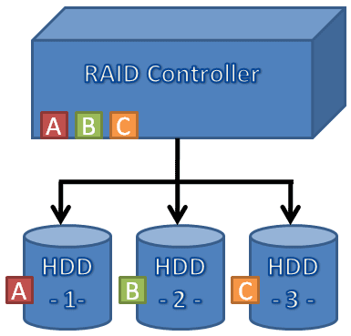
RAID
Redundant Array of Inexpensive Disk
RAID is a method of connecting multiple drives into one logical storage unit.
raid partition used id fd
/dev/md0
Ravi Kant Soni +918269000074
Types of RAID Volume | Type of RAID Level
Simple Volume | None
Spanned Volume | None
Stripped Volume | RAID 0
Mirrored Volume | RAID 1
Stripe set with Parity Volume | RAID 5
Ravi Kant Soni +918269000074

Slide 92
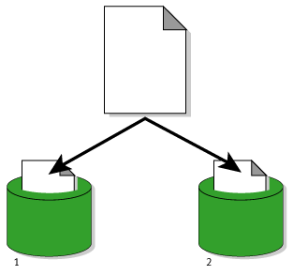
Some of the common RAID levels are –
RAID 0
RAID 1
RAID 5
RAID 0
(Stripped Volume)
RAID 0 is not redundant, In level 0, data is split across drives, resulting in higher data throughput. Since no redundant information is stored, performance is very good, but the failure of any disk in the array results in data loss. This level is commonly referred to as striping.
Ravi Kant Soni +918269000074
100%
50%
50%
Ravi Kant Soni +918269000074

Slide 93
RAID – 1
(Mirror Volume)
RAID 1
RAID Level 1 provides redundancy by writing all data to two or more drives. The performance of a level 1 array tends to be faster on reads and slower on writes compared to a single drive, but if either drive fails, no data is lost. This is a good entry-level redundant system, since only two drives are required; however, since one drive is used to store a duplicate of the data, the cost per megabyte is high. This level is commonly referred to as mirroring.
Ravi Kant Soni +918269000074
100%
100%
100%
Ravi Kant Soni +918269000074

Slide 94
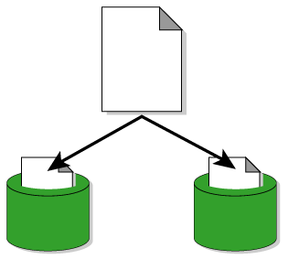
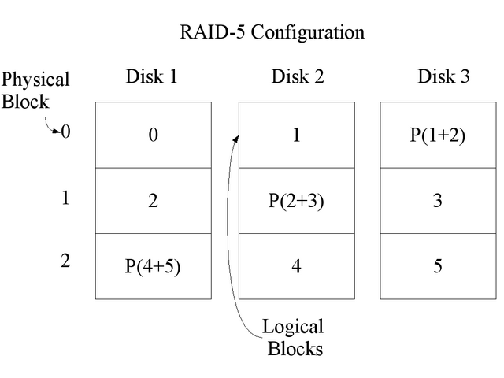

RAID-5
(Stripe set with parity Volume)
RAID 5 stripes data across multiple disks. RAID 5, however, adds a parity check bit to the data. This slightly reduces available disk capacity, but it also means that the RAID array continues to function if a single disk fails. In the event of a disk failure, you simply replace the failed disk and keep going.
Ravi Kant Soni +918269000074
100%
66.6%
66.6%
66.6%
Ravi Kant Soni +918269000074

Slide 95
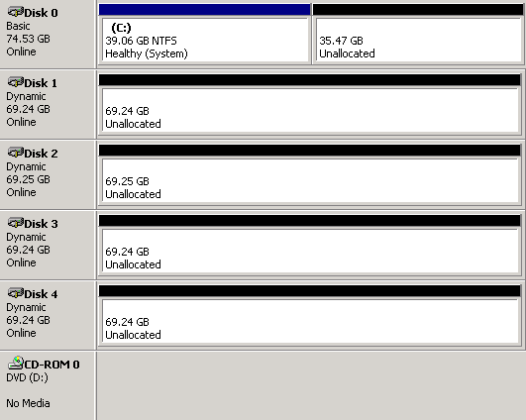
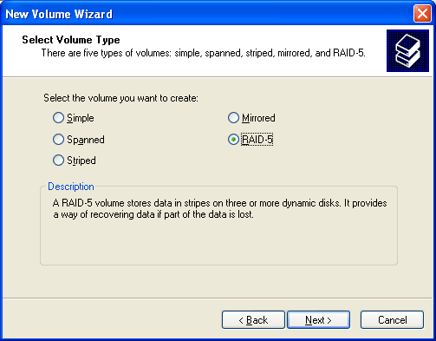
RAID in Windows
Ravi Kant Soni +918269000074
Ravi Kant Soni +918269000074

Slide 96
Two types of RAID
SOFTWARE RAID | HARDWARE RAID
This support to only raid levels not to volumes | This support to all volume & raid level also
This support to only RAID-0, RAID-1, RAID-5 | This support to all volumes
This required to no. partition | This require to no. of hard disk
Ravi Kant Soni +918269000074
Ravi Kant Soni +918269000074

Slide 97
RAID 1 CONFIGURATION
CREATE 2 PARTITION FROM FDISK
[root@station1 /]# fdisk -l
For identify hard disk controller in your hard disk (just like /dev/hda)
For identify cylinder value (Total & Free)
[root@station1 /]# fdisk /dev/hda
Command (m for help): n (for create 2 new partition)
First cylinder (1791-9729, default 1791): Enter
Last cylinder or +size or +sizeM or +sizeK (1791-9729, default 9729): +1024M (For 1GB)
Command (m for help): p (for show the partition table)
Command (m for help): t (for change the partition ID)
Partition number (1-6): 6
Hex code (type L to list codes):fd
Command (m for help): w (for save the partition table)
[root@station1 /]# partprobe
(For update the partition table without reboot)
Ravi Kant Soni +918269000074
Ravi Kant Soni +918269000074

Slide 98
[root@station1 /]# mdadm -C /dev/md0 -l 1 -n 2 /dev/hda{6,7}
For create a raid 1 using partition hda6 & hda7
( -C = create Raid device on md0, -l = Raid level, -n = no. of device in raid)
[root@station1 /]# watch cat /proc/mdstat
For view the status of RAID
[root@station1 /]# mkfs.ext3 /dev/md0
For format to raid device
[root@station1 /]# mount /dev/md0 /mnt
For mount to raid device on /mnt location
[root@station1 /]# df –h
For view the device md0 in mount point
[root@station1 /]# mkdir /mnt/a{1,2,3,4}
For create the data in raid device
Ravi Kant Soni +918269000074
Ravi Kant Soni +918269000074

Slide 99
[root@station1 /]# mdadm --manage /dev/md0 --fail /dev/hda6
For manually fail to hda6 device from raid device
[root@station1 /]# watch cat /proc/mdstat
For view the status of RAID
Again create a 1 more partition from fdisk for add in raid device (like device is hda8)
[root@station1 /]# mdadm --manage /dev/md0 --add /dev/hda8
For add to hda8 device in raid device
[root@station1 /]# mdadm --manage /dev/md0 --remove /dev/hda6
For remove to hda6 device from raid device md0
[root@station1 /]# watch cat /proc/mdstat
For view the status of RAID ( active device hda7 & hda8 )
[root@station1 /]# ls /mnt
You will be see your data is still safe
Ravi Kant Soni +918269000074
Ravi Kant Soni +918269000074

Slide 100
[root@station1 /]# MAKEDEV /dev/md1
For create a new device with the name md1 in /dev location
FOR REMOVE RAID
[root@station1 /]# umount /mnt
For umount to raid device from /mnt
[root@station1 /]# mdadm -S /dev/md0
For stop to /dev/md0 raid devices
Than delete raid partition ( 6,7,8 ) from fdisk
Ravi Kant Soni +918269000074
END
Ravi Kant Soni +918269000074

Slide 101
SWAP EXTEND
Sometimes it is necessary to add more swap space after installation. For example, you may upgrade the amount of RAM in your system from 1024MB to 2048 MB, but there is only 2048MB of swap space. It might be advantageous to increase the amount of swap space to 4096MB if you perform memory-intense operations or run applications that require a large amount of memory.
Three conditions for create one more swap partition:-
      When you increase your Physical RAM after installation
      If you forget about create swap partition during the installation
      If you create less amount of swap partition during the installation
Ravi Kant Soni +918269000074
Ravi Kant Soni +918269000074

Slide 102
[root@station1 /]# free -m
For view the total available Random Access Memory (RAM)
[root@station1 /]# fdisk -l
For identify hard disk controller in your hard disk (just like /dev/hda)
For identify cylinder value (Total & Free)
[root@station1 /]# fdisk /dev/hda
Command (m for help): n
First cylinder (1791-9729, default 1791): Enter
Last cylinder or +size or +sizeM or +sizeK (1791-9729, default 9729): +1024M (For 1GB)
Command (m for help): p (for show the partition table)
Command (m for help): t (for change the partition ID)
Partition number (1-6): 6
Hex code (type L to list codes):82
Command (m for help): w (for save the partition table)
[root@station1 /]# partprobe
(For update the partition table without reboot)
Ravi Kant Soni +918269000074
Ravi Kant Soni +918269000074

Slide 103
[root@station1 /]# swapon -s
For view the current status of swap partition
[root@station1 /]# mkswap /dev/hda6
For format the swap partition
[root@station1 /]# swapoff -a
For off to all swap partition
[root@station1 /]# swapon -p 1 /dev/hda3
For on to hda3 partition in swap with priority 1
[root@station1 /]# swapon -p 2 /dev/hda6
For on to hda6 partition in swap with priority 2
[root@station1 /]# swapon -s
For view the current status of swap partition
Ravi Kant Soni +918269000074
Ravi Kant Soni +918269000074

Slide 104
For permanent mount to hda6 partition on swap
[root@station1 /]# vim /etc/fstab
/dev/hda6 swap swap defaults 0 0
[root@station1 /]# mount -a
For update the fstab file
Ravi Kant Soni +918269000074
For remove swap partition which you have created
[root@station1 /]# swapoff /dev/hda6
For deactive to hda6 swap partition
[root@station1 /]# swapon -s
For view the current status of swap partition
Than delete swap partition from fdisk
END
Ravi Kant Soni +918269000074

Slide 105



USER MANAGEMENT
Two type of users are available in any OS :- Super User
Normal User
Super user who has a default rights at allone
Normal user who has a limited rights
Super User
Normal User
Home directory is stored at
root /root
localuser (abc) /home/abc
Ravi Kant Soni +918269000074

Slide 106
Super user id will be always 0
Normal user id will be always start from 500
1 – 499 uid is reserved for system user
user group uid gid
root root 0 0
user1 user1 500 500
user2 user2 501 501
Ravi Kant Soni +918269000074
Whenever you create any user in linux is belong into their own group
User uid group gid
root 0 root 0
user1 500 user1 500
user2 501 user2 501
abc 502
user3 502 user3 503
Ravi Kant Soni +918269000074

Slide 107
[root@station1 /]# adduser user1
For create user user1
(or)
[root@station1 /]# useradd user1
For create user user1
[root@station1 /]# passwd user1
For set the password of user user1
[root@station1 /]# ls /home
For view the home directory of user1 user
[root@station1 /]# adduser -d /mnt/user2 user2
For create user as well as chage home dir of user (default /home)
[root@station1 /]#ls /mnt/
For view the home dir. of user2 user
Ravi Kant Soni +918269000074
Ravi Kant Soni +918269000074

Slide 108
/etc/group
/etc/shadow
/etc/passwd
That file are responsible for stored user related information
Where store the information of all groups & their GID
[root@station1 /]# cat /etc/group
user1:x:500
group name GID
Where store the information of all users password
[root@station1 /]# cat /etc/shadow
user1:$seW23evnEsdf5fsfsTAFfgrga5efdTfdYdsxf:14361:0:99999:7:::
user name encrypted password
Ravi Kant Soni +918269000074
Ravi Kant Soni +918269000074

Slide 109
Where store the information of users home directory & id’s
[root@station1 /]# cat /etc/passwd
user1:x:500:500:my personal user:/home/user1:/bin/bash
user1 = username
x = password stored in shadow file
500 = uid
500 = gid
my personal user = comment ()
/home/user1 = home directory of user1
/bin/bash = users shell
Available shells in linux & their location
[root@station1 /]# cat /etc/shells
/bin/sh
/bin/bash
/sbin/nologin
/bin/tcsh
/bin/csh
/bin/ksh
Ravi Kant Soni +918269000074
Ravi Kant Soni +918269000074

Slide 110
All setting will be implement on existing user not an new user
[root@station1 /]# usermod -s /sbin/nologin user2
For set nologin shell to user2 user
[root@station1 /]# usermod -s /bin/bash user2
For set to login shell to user2 user
[root@station1 /]# usermod -L user2
For lock to existing user account of user2
[root@station1 /]# usermod -U user2
For unlock to existing user account
[root@station1 /]# usermod -e 2010-12-25 user1
For set expiry date of user1 user
[root@station1 /]# usermod -c “account manager” user1
For set comment for user1 user
[root@station1 /]# usermod -u 700 user1
For change uid for user user1
Ravi Kant Soni +918269000074
Ravi Kant Soni +918269000074

Slide 111
All setting will be implement on new user not an existing user
[root@station1 /]# useradd -s /sbin/nologin user2
For set nologin shell to user2 user
[root@station1 /]# useradd -s /bin/bash user2
For set to login shell to user2 user
[root@station1 /]# useradd -e 2010-12-25 user3
For set expiry date of user3 user
[root@station1 /]# useradd -c “account manager” user4
For set comment for user4 user
[root@station1 /]# useradd -M user5
For create user user5, but home directory will not be create
[root@station1 /]# useradd -u 600 user6
For create user user6, but uid with 600
Ravi Kant Soni +918269000074
Ravi Kant Soni +918269000074

Slide 112
[root@station1 /]# groupadd grp1
For create a new group. It will update entry in /etc/group file
[root@station1 /]# groupadd grp2
For create again new group. It will update entry in /etc/group file
[root@station1 /]# useradd -g grp1 user1
For add to user user1 in grp1 group as a primary group
[user1@station1 ~]$ groups
You can view the groups of user1
[root@station1 /]# useradd -G grp1 user2
For add user user2 to grp1 group but as well as user2 group also
it will add primary group in user2 and secondary as a grp1
[root@station1 /]# useradd -g grp1 -G grp2 user3
For add user3 user into indore group as a primary but it will also
add into mp group as a secondary level
Ravi Kant Soni +918269000074
Ravi Kant Soni +918269000074

Slide 113
DEFAULT PERMISSION FOR DIRECTORY
[root@station1 /]# mkdir /dir1
For create a directory with the name dir1
[root@station1 /]# ls -ld /dir1
For only view the directory permission of dir1
drwxr-xr-x 2 root root 4096 jan 26 11:30 /dir1
d it is a directory
rwxr-xr-x is the permission
2 no. of content stored in /dir1
root owner of that directory
root group of directory
4096 default size of that directory
Jan 26 11:30 modified date & time
/dir1 all above setting of /dir1
Ravi Kant Soni +918269000074
Ravi Kant Soni +918269000074

Slide 114
DEFAULT PERMISSION FOR FILE
[root@station1 /]# touch /file1
For create a file with the name file1
[root@station1 /]# ls -ld /file1
For only view the file permission of file1
-rw-r--r-- 1 root root 0 jan 26 11:30 /file1
- it is a file
rw-r--r-- is the permission
1 no. of content stored in /file1
root owner of that file1
root group of file1
0 default size of that file1
Jan 26 11:30 modified date & time
/file1 all above setting of /file1
Ravi Kant Soni +918269000074
Ravi Kant Soni +918269000074

Slide 115
MAIN COMMANDS FOR PERMISSION
[root@station1 /]# chgrp grp1 /data
For change indore group to data folder
[root@station1 /]# chgrp -R grp1 /data
For change grp1 group to data folder & subfolder also
[root@station1 /]# chmod 777 /data
For change permission on data folder
[root@station1 /]# chmod -R 777 /data
For change permission on data folder & subfolder also
[root@station1 /]# chown user1 /data
For change owner of data folder
[root@station1 /]# chown -R user1 /data
For change owner of data folder & subfolder also
Ravi Kant Soni +918269000074
Ravi Kant Soni +918269000074

Slide 116
[root@station1 /]# setfacl -m u:user1:rw /data
For set acl on data folder
setfacl set file access control list
-m modify in acl
u acl for user
user1 user name
rw rw permission
data permission on data folder
[root@station1 /]# getfacl /data
For view the acl permission of /data folder
[root@station1 /]# setfacl -x u:user1 /data
For remove indusial acl on data folder
[root@station1 /]# setfacl -b /data
For remove all acl on data folder
Ravi Kant Soni +918269000074
Ravi Kant Soni +918269000074

Slide 117
DISK QUOTA
This feature of Linux allows the administrator to allocate a limited size of disk space a user or group may us, Two types of quota are available in linux
Block limits File limits
in kb
You'll need to add the usrquota option for the user and grpquota option for the group in /etc/fstab file to let it know that you are enabling user quotas in your file system
You can apply both type of quota at same time, or you can set quota individually.
Ravi Kant Soni +918269000074
Ravi Kant Soni +918269000074

Slide 118
DISK QUOTA
This feature of Linux allows the administrator to allocate a limited size of disk space a user, Two types of quota are available in linux
Block limits File limits
in kb
You'll need to add the usrquota option for the user in /etc/fstab file to let it know that you are enabling user quotas in your file system You can apply both type of quota at same time, or you can set quota individually.
Ravi Kant Soni +918269000074
Ravi Kant Soni +918269000074

Slide 119
[root@station1 /]# vim /etc/fstab
Old /etc/fstab file
LABEL=/home /home ext3 defaults 1 2
----------------------------------------------------------
New /etc/fstab file
LABEL=/home /home ext3 defaults,usrquota 1 2
esc:wq (save & exit)
Ravi Kant Soni +918269000074
Ravi Kant Soni +918269000074

Slide 120
[root@station1 /]# mount -o remount /home
For remount your partition with usrquota option
[root@station1 /]# quotacheck -mc /home
For check the existing quota and create quota file (aquota.user)
( m = don’t try to remount with Read only
c = don’t try to read existing quota file )
[root@station1 /]# ls /home
You will see the aquota.user in /home
[root@station1 /]# quotaon /home
For quotaon (default quota is off)
[root@station1 /]# adduser user1
For create the user
[root@station1 /]# passwd user1
For set the user password
Ravi Kant Soni +918269000074
Ravi Kant Soni +918269000074

Slide 121
[root@station1 /]# edquota user1
Filesystem blocks soft hard inodes soft hard
/dev/hda5 20 0 0 5 0 0
partition used warning max created warning max
block in KB limit limit file limit limit
esc:wq save & exit
[root@station1 /]# repquota /home
For summrize quotas for a filesystem of all users
[root@station1 /]# edquota -t
For change grace period
[user1@station1 ~]$ quota
User can check their quota limit
Ravi Kant Soni +918269000074
END
Ravi Kant Soni +918269000074

Slide 122
NFS
[root@station1 /]# mkdir -p /soft/a{1,2,3,4,5}
For create the parent directory & sub directory
For share the directory
[root@station1 /]# vi /etc/exports
/soft *(ro,sync)
(or)
/soft 172.24.0.0/255.255.0.0(ro,sync)
(or)
/soft 172.24.0.2(ro,sync)
esc:wq (save & exit)
[root@station1 /]# service portmap restart
For restart to portmap service
[root@station1 /]# service nfs restart
For restart to nfs service
Ravi Kant Soni +918269000074
172.24.0.1
255.255.0.0
NFS Server
Ravi Kant Soni +918269000074

Slide 123

NFS
SERVER
LINUX & WINDOWS
I want to share data from linux server for client
Ravi Kant Soni +918269000074
LINUX
UNIX
W2k8
XP
NFS CLIENTS
NFS CLIENTS
NFS CLIENTS
NFS CLIENTS
Ravi Kant Soni +918269000074

Slide 124
NFS SERVER
[root@station1 /]# mkdir -p /iant/lab{1,2,3,4,5,6,7,8,9}
Create data for sharing
For share entry in this file
[root@station1 /]# vim /etc/exports
/iant 172.24.0.1(ro,sync)
or
/iant 172.24.0.1(ro,sync) 172.24.0.2(rw,sync)
or
/iant 172.24.0.0/255.255.0.0(ro,sync)
esc:wq (for save & exit)
Ravi Kant Soni +918269000074
172.24.0.1
255.255.0.0
NFS Server
Ravi Kant Soni +918269000074

Slide 125
[root@station1 /]# service portmap restart
For restart the service portmap
[root@station1 /]# service nfs restart
For restart the service nfs
[root@station1 /]# chkconfig portmap on
For permanently on to portmap service
[root@station1 /]# chkconfig nfs on
For permanently on to nfs service
[root@station1 /]# exportfs
For view the shared data from local server
Ravi Kant Soni +918269000074
Switch to client machine
Ravi Kant Soni +918269000074

Slide 126
NFS CLIENT
For view the shared content of 172.24.0.1
[root@station2 /]# showmount -e 172.24.0.1
/iant 172.24.0.0/255.255.0.0
[root@station2 /]# mount 172.24.0.1:/iant /mnt
For mount to iant folder on /mnt folder, which is shared from server
[root@station2 /]# df -h
172.24.0.1:/iant /mnt
[root@station2 /]# ls /mnt
For view the content of /mnt folder
[root@station2 /]# umount /mnt
For umount to /mnt folder
Ravi Kant Soni +918269000074
172.24.0.2
255.255.0.0
NFS Client
END
Ravi Kant Soni +918269000074

Slide 127
RPM INSTALLATION
Linux platform is require .rpm file for installation, rather than windows use .exe file
RPM = Redhat Package Manager
You can install rpm files from CD / DVD / USB / SERVER
[root@station1 /]# rpm -qa
For view total installed rpm
[root@station1 /]# mount 172.24.254.254:/rhel5.3 /mnt
For mount to server location rhel5.3
[root@station1 /]# df -h
For view to mounted data
[root@station1 /]# cd /mnt/Server
To switch Server directory where all rpm is stored
[root@station1 Server]# ls
You will be see all rpm is stored at here
Ravi Kant Soni +918269000074
Ravi Kant Soni +918269000074

Slide 128
vsftpd-2.0.5-10.el5.i386.rpm
package package os arch extension
name version
[root@station1 Server]# rpm -ivh vsftpd*
For install to dialog rpm ( i = install, v = verbose, h = print hash )
[root@station1 Server]# rpm -q vsftpd
vsftpd-2.0.5-10.el5
For package query ( package is installed or not)
[root@station1 Server]# rpm -ql vsftpd
For show the list files in packages ( q = query, l = list )
[root@station1 /]# rpm -e vsftpd
For erase vsftpd package
Ravi Kant Soni +918269000074
Ravi Kant Soni +918269000074

Slide 129
[root@station1 Server]# rpm -ivh telnet*
It will prompt for install first dependency package xinetd
[root@station1 Server]# rpm -ivh telnet* --nodeps
For install telnet package without dependency
[root@station1 Server]# rpm -Uvh telnet*
For upgrage to any older version
( U = upgrade, v = verbose, h = hash)
Ravi Kant Soni +918269000074
Ravi Kant Soni +918269000074

Slide 130
[root@station1 Server]# which mdadm
/sbin/mdadm
For identify the location of mdadm command
[root@station1 Server]# rm -rf /sbin/mdadm
For remove the mdadm command
[root@station1 Server]# rpm -ivh mdadm* --force
For reinstall to any package
( if that package is already install but some file is missing)
Ravi Kant Soni +918269000074
END
Ravi Kant Soni +918269000074

Slide 131
YUM
YUM stands for Yellowdog Updater Modified
Yum is software installation tool for Redhat linux and Fedora Linux, It is a complete software management system. yum is designed to use over network/internet. It does not use
CDROM to install packages.
Ravi Kant Soni +918269000074
YUM CLIENT
YUM SERVER
Ravi Kant Soni +918269000074

Slide 132
YUM CLIENT
    Configuration of YUM Client
[root@station1 /]# cd /etc/yum.repos.d
For switch into configurable directory
[root@station1 yum.repos.d]# rm -rf *.repo
For remove default configuration file
For create new configuration file with extension ( .repo )
[root@station1 yum.repos.d]# vim yum.repo
[not-install]
baseurl=ftp://172.24.254.254/pub/Server
gpgcheck=0
esc:wq (save & exit)
[root@station1 yum.repos.d]# yum clean all
For clean to default cache entry
Ravi Kant Soni +918269000074
Ravi Kant Soni +918269000074

Slide 133
YUM CLIENT
[root@station1 /]# yum list
To list for all packages either installed or not
[root@station1 /]# yum list installed
To list for only installed packages
[root@station1 /]# yum install vsftpd*
For install to vsftpd package, it will prompt for confirmation ( y/n )
[root@station1 /]# yum list vsftpd*
To query for vsftpd package
[root@station1 /]# yum remove vsftp*
For remove vsftpd package
[root@station1 /]# yum install http*
To install http package and dependency package also
[root@station1 /]# yum info vsftp*
For view information about your package
Ravi Kant Soni +918269000074
Ravi Kant Soni +918269000074

Slide 134
YUM SERVER
    Configuration of YUM SERVER
You can configure YUM server for provide installation packages to the client machine, We need to all rpm file on server for configure to YUM. You can copy from another machine or from CD/DVD
[root@station1 /]# mount /dev/cdrom /mnt
For mount to cdrom on /mnt
(or)
[root@station1 /]# mount 172.24.254.254:/rhel5.3 /mnt
For mount to server location on /mnt
[root@station1 /]# cd /mnt/Server
For switch into Server directory
[root@station1 Server]# rpm -ivh vsftpd*
For install to ftp server packages
[root@station1 Server]# rpm -ivh createrepo*
This package is use for configure to yum server
Ravi Kant Soni +918269000074
Ravi Kant Soni +918269000074

Slide 135
[root@station1 Server]# mkdir /var/ftp/pub/yum
For create a directory where you will store all rpm
[root@station1 Server]# cp -rv *.rpm /var/ftp/pub/yum
For copy all rpm files at yum folder
[root@station1 /]# umount /mnt
For umount to /mnt location ( after switch to / location )
[root@station1 /]# createrepo /var/ftp/pub/yum
For configure to yum server
[root@station1 /]# service vsftpd restart
For restart to ftp service
[root@station1 /]# chkconfig vsftpd on
For permanently on to ftp service
Ravi Kant Soni +918269000074
CONGRATULATION YOUR YUM SERVER IS READY
SWITCH TO CLIENT MACHINE
END
Ravi Kant Soni +918269000074

Slide 136
SAMBA SERVER
LINUX SERVER
I want to share data from linux server for windows client
Ravi Kant Soni +918269000074
LINUX
UNIX
W2k8
XP
SMB CLIENTS
SMB CLIENTS
SMB CLIENTS
SMB CLIENTS
Ravi Kant Soni +918269000074

Slide 137
SAMBA SERVER
    Configuration of SMB SERVER
SMB is specially use for share the data from linux server to windows clients. For install to samba server first
configure to YUM client
[root@station1 /]# yum install samba*
For install to packages of samba
[root@station1 /]# mkdir -p /IANT/lab{1,2,3,4,5}
Create any directory for share
Ravi Kant Soni +918269000074
Ravi Kant Soni +918269000074

Slide 138
SAMBA SERVER
[root@station1 /]# vim /etc/samba/smb.conf
workgroup = indore line no. 74
[IANT] share name
comment = IANT comment
path = /IANT location of the folder
valid users = user1 allow to only user1
hosts allow = 172.24.0.2 user1 can access from this IP
public = yes
writable = yes
printable = yes
browseable = yes
esc:wq (Save & exit)
[root@station1 /]# adduser user1
Create user for access to share folder from 172.24.0.1
[root@station1 /]# smbpasswd -a user1
password:123
Retype-password:123
For set smb password to user1, we don’t need to set password via passwd
Ravi Kant Soni +918269000074
Ravi Kant Soni +918269000074

Slide 139
[root@station1 /]# setup
For view the status of selinux in Firewall Configuration
security level should be disabled
[root@station1 /]# chcon -t samba_share_t /IANT -R
Change selinux context ( if selinux is enabled )
[root@station1 /]# ls -lZd /IANT
For see selinux context ( if selinux is enabled )
[root@station1 /]# service smb restart
For restart the smb service
[root@station1 /]# chkconfig smb on
For permanent on to smb service
Now switch to client machine
Ravi Kant Soni +918269000074
Ravi Kant Soni +918269000074

Slide 140
SAMBA CLIENT
LINUX
SMB CLIENT
[root@station2 /]# ping 172.24.0.1
Client successful ping to smb server
For view the list of share folder on smb server
[root@station2 /]# smbclient -L 172.24.0.1
password:Enter You will be login via anonymous user
[root@station2 /]# smbclient //172.24.0.1/IANT -U user1
password:123
smb> You will be get this prompt after login
Ravi Kant Soni +918269000074
Ravi Kant Soni +918269000074

Slide 141
SAMBA CLIENT
Any
window
W2K8
VISTA
XP
SMB CLIENTS
SMB CLIENTS
SMB CLIENTS
SMB CLIENTS
How to access shared folder from windows machine
Two ways :- From Command prompt
From Graphical Enviornment
For command Prompt
Start - Run – cmd
C:\> net use m: \\172.24.0.1\IANT
Enter user name for 172.24.0.1 : user1
Enter password for 172.24.0.1 : 123
Ravi Kant Soni +918269000074
Ravi Kant Soni +918269000074

Slide 142
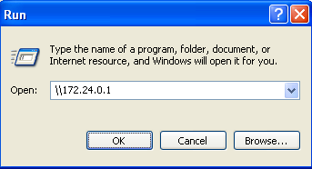
SAMBA CLIENT
Any
window
W2K8
VISTA
XP
SMB CLIENTS
SMB CLIENTS
SMB CLIENTS
SMB CLIENTS
For graphical
Start - Run
Ravi Kant Soni +918269000074
Ravi Kant Soni +918269000074

Slide 143
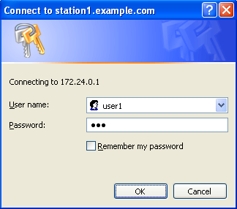
Type user name who is created on smb server :- user1
Type password who is assigned on smb server :- 123
Ravi Kant Soni +918269000074
Ravi Kant Soni +918269000074

Slide 144
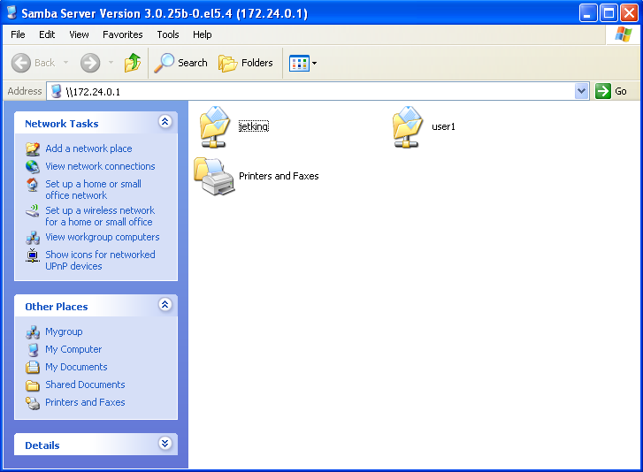
Ravi Kant Soni +918269000074
You will be see shared content on you local machine
Ravi Kant Soni +918269000074

Slide 145
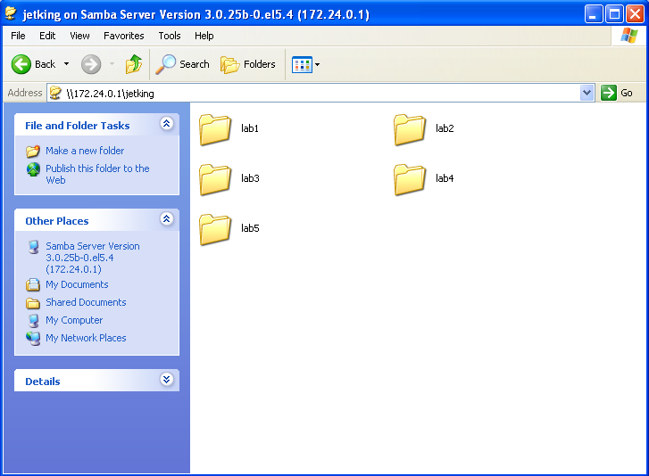
Ravi Kant Soni +918269000074
Is the shared content on you local machine
END
Ravi Kant Soni +918269000074

Slide 146
Use the mount command as follows:
# mount -t cifs //ntserver/download -o username=kailash,password=myPassword /mnt
# mount -t cifs //ntserver/download -o username=kailash /mnt
Password:
Use following command if you are using Old version such as RHEL <=4 or Debian <= 3:
# mount -t smbfs -o username=kailash,password=D1W4x9sw //ntserver/download /mnt
mount.cifs "//slickbox/users" /mnt -o user=kain Password: <type in windows network password here>
//slickbox/users /SlickboxUsers cifs user=kain,pass=userpass,rw,users 0 0 in fstab
Ravi Kant Soni +918269000074
Common Internet File System is an application-level network protocol mainly used to provide shared access to files, printers, serial ports, and miscellaneous communications between nodes on a network. You can easily access CIFS share from Linux and mount them as a regular filesystem.
Q. How do I mount CIFS Windows Server / XP / Vista Shared folder under Linux operating systems?
Linux mount CIFS Windows Share
Ravi Kant Soni +918269000074

Slide 147
FILE TRANSFER PROTOCOL (FTP)
File Transfer Protocol
Allows upload and downloading of files not to directory
One of the oldest TCP/IP services And still widely in use
Client/Server protocol
Universal Protocol not depend any OS
FTP can be used over the internet
It can access via url location ( ftp://serverip)
    Advantages over HTTP file transfer
      Allows inspection of file tree, includes file sizes and timestamps
      No HTML code required
    Caution!
      Improperly configured ftp servers are security risks
Ravi Kant Soni +918269000074
Ravi Kant Soni +918269000074

Slide 148
FTP SERVER
File Transfer Protocol (FTP) is a standard network protocol used to exchange and manipulate files over a TCP/IP based network, such as the Internet. FTP is built on a client-server architecture and utilizes separate control and data connections between the client and server applications. Applications were originally interactive command-line tools with a standardized command syntax, but graphical user interfaces have been developed for all desktop operating systems in use today. FTP is also often used as an application component to automatically transfer files for program internal functions. FTP can be used with user-based password authentication or with anonymous user access.
The Trivial File Transfer Protocol (TFTP) is a similar but simplified, unauthenticated version and not a browsing capability
A client makes a connection to the server using TCP port 21. This connection, called the control connection, remains open for the duration of the session, with a second connection on port 20 opened as required to transfer file data. Commands are sent by the client over the control connection, and for download the file use port 21
Ravi Kant Soni +918269000074
Ravi Kant Soni +918269000074

Slide 149
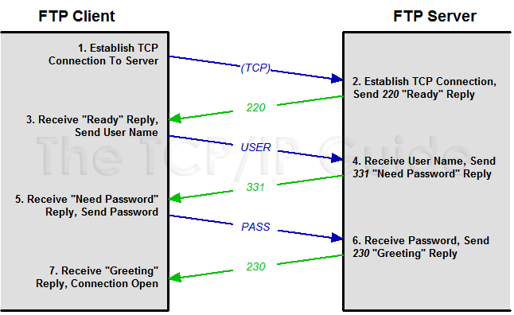
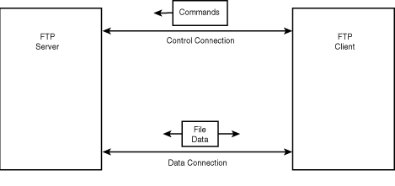
FTP Connection Establishment and User Authentication
Port 21
Random Port
Port 20
Random Port
Ravi Kant Soni +918269000074

Slide 150
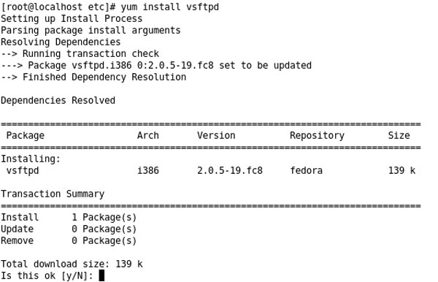
VSFTPD Very Secured File Transfer Protocol Daemon (Package)
For install to ftp server first configure to YUM client
Ravi Kant Soni +918269000074
Not-install
Ravi Kant Soni +918269000074

Slide 151
FTP SERVER
The /var/ftp directory will automatically create when you install vsftpd packages
Anonymous user can access all file which is stored at and under /var/ftp location
Local user can download to any files which has atleast read permission on that file
By default all user can download the file from server
Create any file at /var/ftp for download on client
[root@station1 /]# vim /var/ftp/test
test file for download…………………………………………………….
[root@station1 /]# service vsftpd restart
For restart the service of ftp
[root@station1 /]# chkconfig vsftpd on
For permanent on to ftp service
[root@station1 /]# chkconfig --list vsftpd
For view the status of vsftpd,
Ravi Kant Soni +918269000074
Ravi Kant Soni +918269000074

Slide 152
DOWNLOAD FROM FTP CLIENT
Anonymous user can access all file which is stored at and under /var/ftp location
Local user can download to any files which has atleast read permission on that file
By default all user can download the file from server.
For connect to FTP server
[root@station2 /]# ftp 172.24.0.1
Connected to 172.24.0.1
User <172.24.0.1:<none>>:ftp
Password:Enter
Login successful.
ftp>ls (For view the content of ftp server)
test
pub
ftp>get test (For download the file from server)
File send ok
ftp>bye (For exit from server)
[root@station2 /]#ls
You can see download files on your local system
Ravi Kant Soni +918269000074
Ravi Kant Soni +918269000074

Slide 153
CONFIGURATION ON FTP FOR UPLOAD
For upload data on server from client, first allow t
[root@station1 /]# vim /etc/vsftpd/vsftpd.conf
#anon_upload_enable=YES [ Remove # {hash} for enable upload]
esc:wq (save & exit)
[root@station1 /]# chmod 757 /var/ftp/pub
For assign to permission on pub folder where client can upload data
[root@station1 /]# service vsftpd restart
For restart the service of ftp
[root@station1 /]# chkconfig vsftpd on
For permanent on to ftp service
Ravi Kant Soni +918269000074
Ravi Kant Soni +918269000074

Slide 154
UPLOAD FROM FTP CLIENT
Anonymous user can upload all file at /var/ftp/pub location
For connect to FTP server
[root@station2 /]# ftp 172.24.0.1
Connected to 172.24.0.1
User <172.24.0.1:<none>>:ftp
Password:Enter
Login successful.
ftp>cd pub (For switch into pub folder for upload)
Directory successfully changed
ftp>put file1 (For upload the file on server at pub location)
File recieved ok
ftp>bye (For exit from server)
Ravi Kant Soni +918269000074
Ravi Kant Soni +918269000074

Slide 155
FTP SERVER SECURTIY
User Based Security
This file is use for deny to any user for login via ftp
[root@station1 /]# vim /etc/vsftpd/ftpusers
root
user1
Ravi Kant Soni +918269000074
IP Based Security
Configure TCP Wrapper Security for IP Based
Two files will be use for configure TCP WRAPPER
/etc/hosts.allow
Entry of the IP or network who is allow to use tcp services ( like ftp )
/etc/hosts.deny
Entry of the IP or network who is deny to use tcp services ( like ftp )
Ravi Kant Soni +918269000074

Slide 156
TCP WRAPPER CONFIGURATION
Result : Allow to only 172.24.0.1 IP and deny to all other network and IP
[root@station1 /]# vim /etc/hosts.allow
vsftpd: 172.24.0.1
[root@station1 /]# vim /etc/hosts.deny
vsftpd: ALL
Result : Allow to only 172.24.0.0 N/W and deny to all other network
[root@station1 /]# vim /etc/hosts.allow
vsftpd: 172.24.0.0/255.255.0.0
[root@station1 /]# vim /etc/hosts.deny
vsftpd: ALL
Ravi Kant Soni +918269000074
Result : Allow to all N/W and deny to 172.24.0.1 IP
[root@station1 /]# vim /etc/hosts.allow
vsftpd: ALL EXCEPT 172.24.0.1
[root@station1 /]# vim /etc/hosts.deny
vsftpd: 172.24.0.1
Result : Allow to all N/W and deny to 172.24.0.1 172.24.0.2 IP
[root@station1 /]# vim /etc/hosts.allow
vsftpd: ALL EXCEPT 172.24.0.1 172.24.0.2
[root@station1 /]# vim /etc/hosts.deny
vsftpd: 172.24.0.1 172.24.0.2
END
Ravi Kant Soni +918269000074

Slide 157
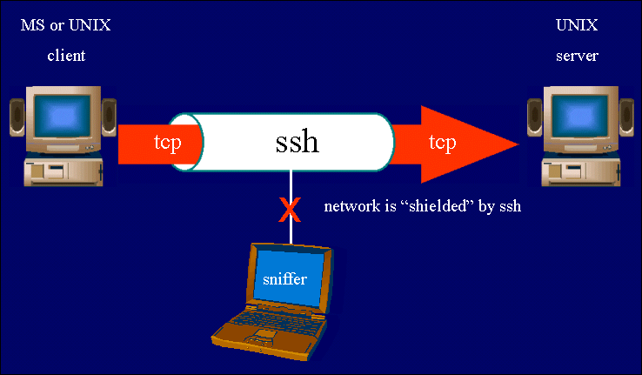
SSH ( SECURE SHELL )
OpenSSH is a FREE version of the SSH connectivity tools that technical users of the Internet rely on. OpenSSH encrypts all traffic (including passwords) to effectively eliminate eavesdropping, connection hijacking, and other attacks. Additionally, OpenSSH provides secure tunneling capabilities and several authentication methods, and supports all SSH protocol versions. Whenever data is sent by a computer to the network, SSH automatically encrypts it. When the data reaches its intended recipient, SSH automatically decrypts (unscrambles) it. By default ssh is installed on all linux computers and allow to all users from all network. SSH works on port no. 22
Windows or LINUX
LINUX
Ravi Kant Soni +918269000074
Ravi Kant Soni +918269000074

Slide 158
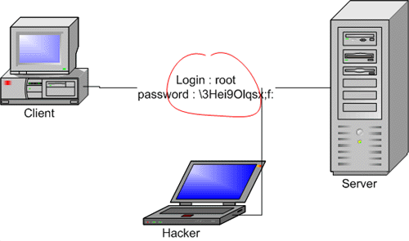
Ravi Kant Soni +918269000074
SSH CLIENT
[root@station2 /]# ssh 172.24.0.1
For connect to 172.24.0.1 machine via ssh with root user
[root@station2 /]# ssh abc@172.24.0.1
For connect to 172.24.0.1 machine via ssh with abc user
[root@station2 /]# scp -r 172.24.0.1:/root/test /tmp
For secure copy test file from 172.24.0.1 at /tmp on local machine
Ravi Kant Soni +918269000074

Slide 159
SSH SERVER SECURTIY
User Based Security
This file is use for allow to specific user for login via ssh, by default deny to all other users
[root@station1 /]# vim /etc/ssh/sshd_config
allowusers root user1
[root@station1 /]# service sshd restart
For restart the service off ssh
[root@station1 /]# chkconfig sshd on
For permanently on to ssh service
[root@station1 /]# chkconfig --list sshd
For view the status of sshd,
Ravi Kant Soni +918269000074
IP Based Security
Configure TCP Wrapper Security for IP Based
/etc/hosts.allow
/etc/hosts.deny
Ravi Kant Soni +918269000074

Slide 160
TCP WRAPPER CONFIGURATION
Result : Allow to only 172.24.0.1 IP and deny to all other network and IP
[root@station1 /]# vim /etc/hosts.allow
sshd: 172.24.0.1
[root@station1 /]# vim /etc/hosts.deny
sshd: ALL
Result : Allow to only 172.24.0.0 N/W and deny to all other network
[root@station1 /]# vim /etc/hosts.allow
sshd: 172.24.0.0/255.255.0.0
[root@station1 /]# vim /etc/hosts.deny
sshd: ALL
Ravi Kant Soni +918269000074
Result : Allow to all N/W and deny to 172.24.0.1 IP
[root@station1 /]# vim /etc/hosts.allow
sshd: ALL EXCEPT 172.24.0.1
[root@station1 /]# vim /etc/hosts.deny
sshd: 172.24.0.1
Result : Allow to all N/W and deny to 172.24.0.1 172.24.0.2 IP
[root@station1 /]# vim /etc/hosts.allow
sshd: ALL EXCEPT 172.24.0.1 172.24.0.2
[root@station1 /]# vim /etc/hosts.deny
sshd: 172.24.0.1 172.24.0.2
END
Ravi Kant Soni +918269000074

Slide 161
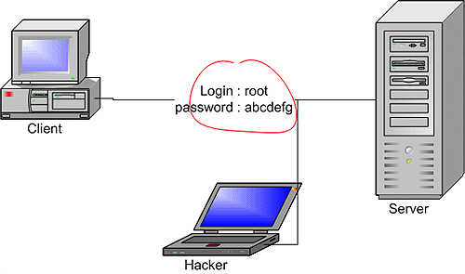
TELNET
Telnet (teletype network) is a network protocol used on the Internet or local area networks. You can then enter commands through the Telnet program and they will be executed as if you were entering them directly on the server console. This enables you to control the server and communicate with other servers on the network. To start a Telnet session, you must log in to a server by entering a valid username and password. Telnet provides plain text authentication not a encrypted. Telnet is available on all Operating System but you have to install & configure in linux OS. Root user is not allow to login in telnet . Telnet works on port no 23
Ravi Kant Soni +918269000074
Ravi Kant Soni +918269000074

Slide 162
TELNET SERVER CONFIGURATION
For install to telnet server first configure to YUM client
[root@station1 /]# yum install telnet*
For install the package of telnet
For enable to telnet ( by default is disabled)
[root@station1 /]# vim /etc/xinetd.d/telnet
disable = yes
esc:wq (save & exit)
[root@station1 /]# service xinetd restart
For restart the service of telnet
[root@station1 /]# chkconfig xinetd on
For permanent on to xinetd service
Now switch to client machine
Ravi Kant Soni +918269000074
Ravi Kant Soni +918269000074

Slide 163
TELNET SERVER SECURTIY
IP Based Security
Configure TCP Wrapper Security for IP Based
Two files will be use for configure TCP WRAPPER
Ravi Kant Soni +918269000074
/etc/hosts.allow
Entry of the IP or network who is allow to use tcp services ( like telnet )
/etc/hosts.deny
Entry of the IP or network who is deny to use tcp services ( like telnet )
Ravi Kant Soni +918269000074

Slide 164
TCP WRAPPER CONFIGURATION
Result : Allow to only 172.24.0.1 IP and deny to all other network and IP
[root@station1 /]# vim /etc/hosts.allow
in.telnetd: 172.24.0.1
[root@station1 /]# vim /etc/hosts.deny
in.telnetd: ALL
Result : Allow to only 172.24.0.0 N/W and deny to all other network
[root@station1 /]# vim /etc/hosts.allow
in.telnetd: 172.24.0.0/255.255.0.0
[root@station1 /]# vim /etc/hosts.deny
in.telnetd: ALL
Ravi Kant Soni +918269000074
Result : Allow to all N/W and deny to 172.24.0.1 IP
[root@station1 /]# vim /etc/hosts.allow
in.telnetd: ALL EXCEPT 172.24.0.1
[root@station1 /]# vim /etc/hosts.deny
in.telnetd: 172.24.0.1
Result : Allow to all N/W and deny to 172.24.0.1 172.24.0.2 IP
[root@station1 /]# vim /etc/hosts.allow
in.telnetd: ALL EXCEPT 172.24.0.1 172.24.0.2
[root@station1 /]# vim /etc/hosts.deny
in.telnetd: 172.24.0.1 172.24.0.2
Ravi Kant Soni +918269000074

Slide 165
TELNET CLIENT
All user can make connection with telnet server
For connect to TELNET server
[root@station2 /]# telnet 172.24.0.1
login: use r1
Password:123
[user1@station1 ~]$ (You have successfully connect to telnet server)
[user1@station1 ~]$ su – root (You can switch via root user)
Ravi Kant Soni +918269000074
END
Ravi Kant Soni +918269000074

Slide 166
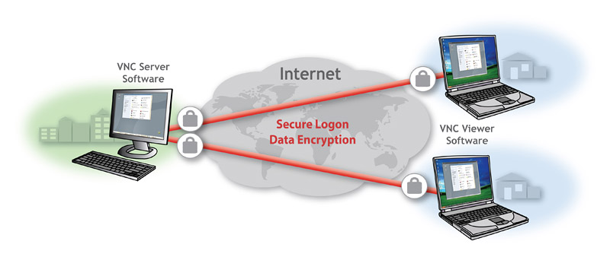
Virtual Network Computing ( VNC )
Virtual Network Computing (VNC) is a graphical desktop sharing system that uses for remotely control to another computer. It transmits the keyboard and mouse events from one computer to another, relaying the graphical screen updates back in the other direction, over a network.
VNC is platform-independent – a VNC viewer on one operating system may connect to a VNC server on the same or any other operating system. Multiple clients may connect to a VNC server at the same time. VNC works on port no. 5900
Popular uses for this technology include remote technical support and accessing files on one's work computer from one's home computer, or vice versa.
Ravi Kant Soni +918269000074
Ravi Kant Soni +918269000074

Slide 167
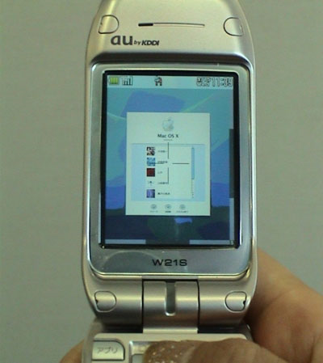

Virtual Network Computing ( VNC )
VNC in Mobile
VNC in Computer
Ravi Kant Soni +918269000074
Ravi Kant Soni +918269000074

Slide 168
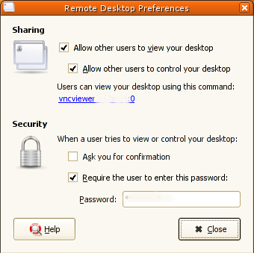
VNC SERVER CONFIGURATION
For install to vnc server first configure to YUM client on both machine VNC Server & Client
[root@station1 /]# yum install vnc*
For install the package of telnet
by opening the "System" menu, "Preferences" and then selecting "Remote desktop". You will
be presented with a dialog like the following:
Ravi Kant Soni +918269000074
Now switch to client machine
END
Ravi Kant Soni +918269000074

Slide 169
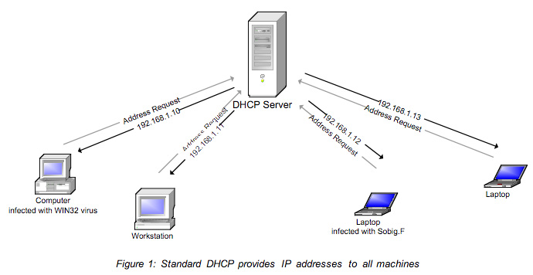
DHCP SERVER
Dynamic Host Configuration Protocol
Ravi Kant Soni +918269000074
Ravi Kant Soni +918269000074

Slide 170
DHCP SERVER
A DHCP Server assigns IP addresses to client computers. This is very often used in enterprise networks to reduce configuration efforts. All IP addresses of all computers are stored in a database that resides on a server machine. A DHCP server can provide configuration settings using two methods
Address Pool
This method entails defining a pool (sometimes also called a range or scope) of IP addresses from which DHCP clients are supplied their configuration properties dynamically and on a fist come first serve basis. When a DHCP client is no longer on the network for a specified period, the configuration is expired and released back to the address pool for use by other DHCP Clients.
MAC Address (Reservation/Fixed Address)
This method entails using DHCP to identify the unique hardware address of each network card connected to the network and then continually supplying a constant configuration each time the DHCP client makes a request to the DHCP server using that network device.
Ravi Kant Soni +918269000074
Ravi Kant Soni +918269000074

Slide 171
CONFIGURATION OF DHCP SERVER
[root@station1 /]# yum install dhcp*
For install to packages of dhcp
[root@station1 /]# cp /usr/share/doc/dhcp-3.0.5/dhcpd.conf.sample /etc/dhcpd.conf
For copy sample file at /etc location
[root@station1 /]# vim /etc/dhcpd.conf
subnet 172.24.0.0 netmask 255.255.0.0 {
range dynamic-bootp 172.24.0.101 172.24.0.150;
host station175 {
next-server server1.example.com;
hardware ethernet 12:34:56:78:AB:CD;
fixed-address 172.24.0.175;
}
Ravi Kant Soni +918269000074
Ravi Kant Soni +918269000074

Slide 172
CONFIGURATION OF DHCP SERVER
[root@station1 /]# service dhcpd restart
For restart the service of dhcp
[root@station1 /]# chkconfig dhcpd on
For permanently on to dhcp service
Ravi Kant Soni +918269000074
Now switch to client machine
Ravi Kant Soni +918269000074

Slide 173
DHCP CLIENT
LINUX
DHCP CLIENTS
[root@station2 /]# neat-tui
Choose edit a device params
select eth0
Use DHCP
[root@station1 /]# service network restart
For restart to network service, your machine will be send request for IP to DHCP server (permanently).
(or)
[root@station1 /]# dhclient
For send request on DHCP server for get dynamic IP (temporary)
Ravi Kant Soni +918269000074
Ravi Kant Soni +918269000074

Slide 174
DHCP CLIENT
WINDOW
DHCP CLIENTS
Right Click on
My Network Place – Properties
Double Click on
Local Area Connection – Intenet Protocol(TCP/IP)
Choose Options
Obtain IP Address Automatically – OK
It will send request on DHCP server for get Dynamic IP Address
Ravi Kant Soni +918269000074
END
Ravi Kant Soni +918269000074

Slide 175

KICKSTART SERVER
What is Kickstart?
Kickstart is a mechanism allowing automated and unattended system installations,
Red Hat has created the kickstart installation method. With this method, a system administrator can create a single file containing the answers to all the questions that would normally be asked during a typical Red Hat interactive Linux installation.
Kickstart files can be kept on single server system, and read by individual computers during the installation. The kickstart installation method is powerful enough that often a single kickstart file can be used to install Red Hat Linux on multiple machines, making it ideal for network and system administrators. You have to install ftp package
Ravi Kant Soni +918269000074
Ravi Kant Soni +918269000074

Slide 176

KICKSTART
SERVER
Ravi Kant Soni +918269000074
Ravi Kant Soni +918269000074

Slide 177
For install to kickstart server first configure to YUM client
[root@station1 /]# yum install system-config-kickstart*
For install the package of kickstart server
[root@station1 /]# yum install vsftpd*
For share to the answer file you have to install the package of ftp
[root@station1 /]# service vsftpd restart
For restart the service of vsftpd
[root@station1 /]# chkconfig vsftpd on
For permanent on ftp service
Ravi Kant Soni +918269000074
Ravi Kant Soni +918269000074

Slide 178
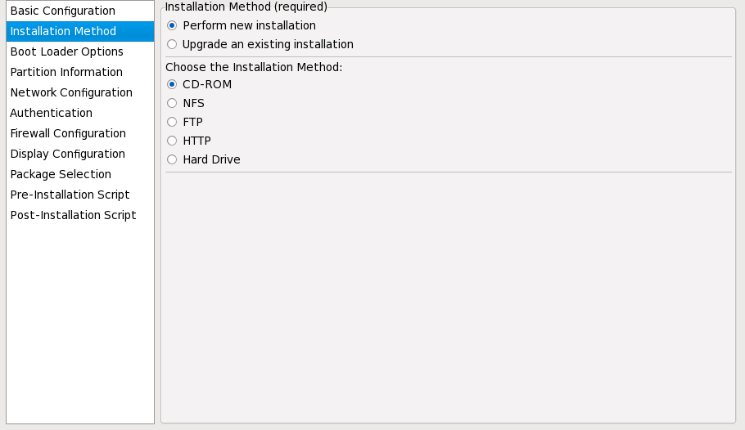
Click on Application-system tools-kickstart
Ravi Kant Soni +918269000074
Click on File menu than save in /var/ftp/ks.cfg
Ravi Kant Soni +918269000074

Slide 179
CLIENT SETTING
Boot From CD/DVD/Network
Ravi Kant Soni +918269000074
linux ks=ftp://172.24.0.1/ks.cfg
END
Ravi Kant Soni +918269000074

Slide 180
TROUBLESHOOTING
For set default runlevel & create new terminal type (tty)
[root@station1 /]# vim /etc/inittab
id:3:initdefault: For set default run level
1:2345:respawn:/sbin/mingetty tty1
2:2345:respawn:/sbin/mingetty tty2
3:2345:respawn:/sbin/mingetty tty3
4:2345:respawn:/sbin/mingetty tty4
5:2345:respawn:/sbin/mingetty tty5
6:2345:respawn:/sbin/mingetty tty6
7:2345:respawn:/sbin/mingetty tty7
8:2345:respawn:/sbin/mingetty tty8
esq:wq (save & exit)
[root@station1 /]# reboot
For reboot, b’coz “tty” will create after installation
Ravi Kant Soni +918269000074
linux ks=ftp://172.24.0.1/ks.cfg
Ravi Kant Soni +918269000074

Slide 181
TROUBLESHOOTING
For set grub password
[root@station1 /]# grub-md5-crypt >> /etc/grub.conf
redhat
redhat
[root@station1 /]# vim /etc/grub.conf
[root@station1 /]# reboot
For reboot, b’coz “tty” will create after installation
Ravi Kant Soni +918269000074
linux ks=ftp://172.24.0.1/ks.cfg
Ravi Kant Soni +918269000074

